Slide 1
From Mainframes to Micros
How I came to create Apple DOS 3.1, Atari Basic, Cromemco C, Digital Cameras and more.
Notes:
American start speeches with a joke
Spent some time in Japan
Learned that Japanese start their speeches with an apology
I am going to pay homage to both cultures
I humbly apologize to you for not starting this speech with a joke

Slide 2

My Passion
Do what you love,
Love what you do,
And you will love your life
COMPUTERS!
Notes:
My father, an electronics engineer and a geek like me, once told me
I have tried to live by this rule
This means that I needed to choose a career that I loved
Computers did not start out as my passion

Slide 3
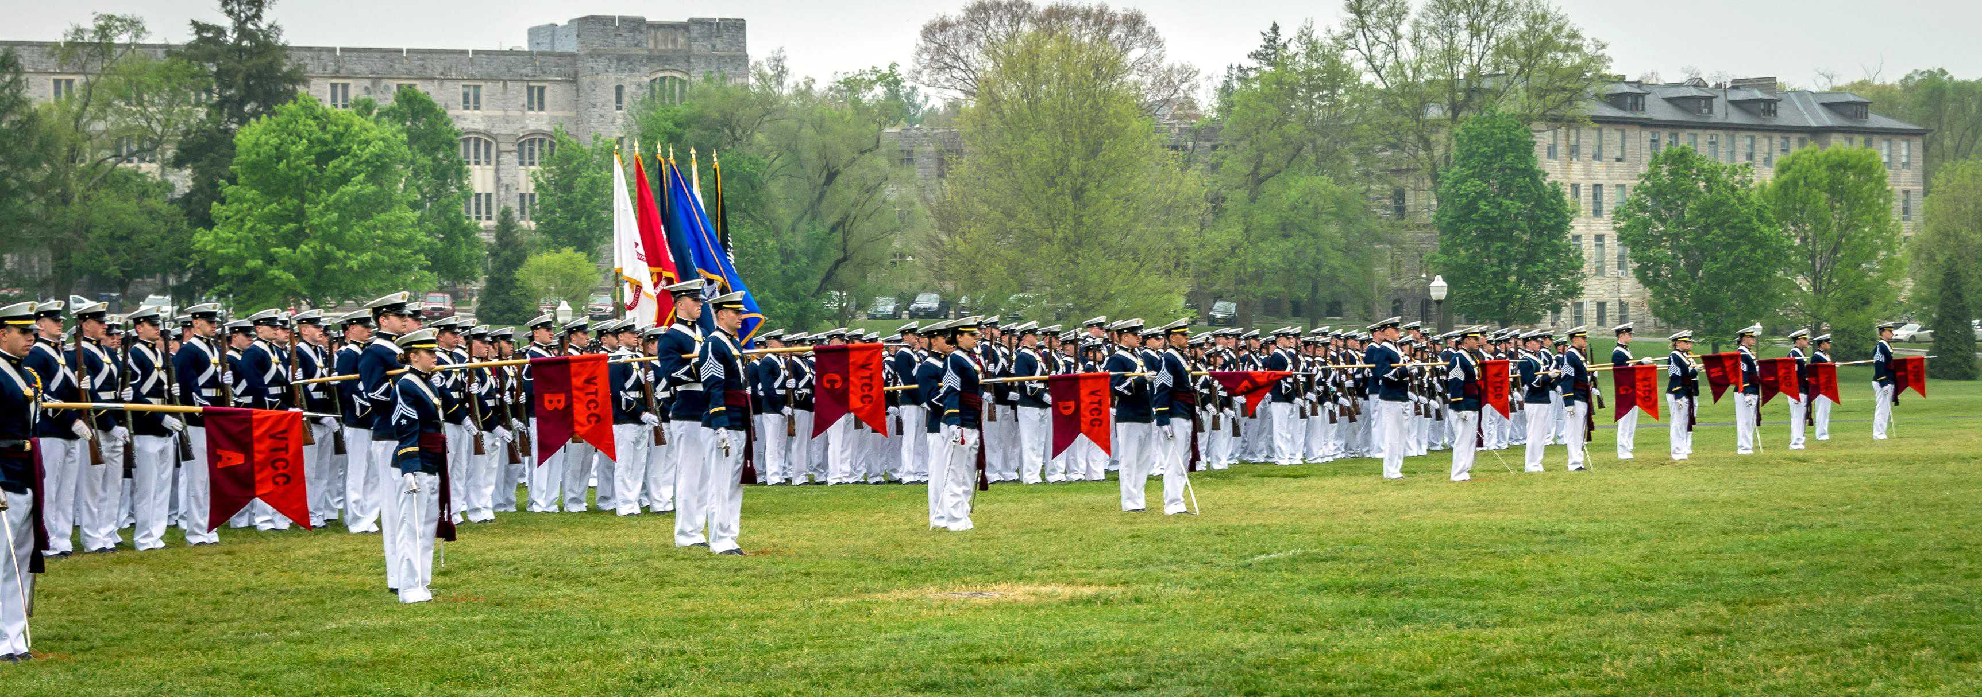
VPI
Virginia Tech
Full time Corps of Cadets
Majoring in physics
Notes:
I chose Virginia Tach because I wanted to become
What the Air Force called a Scientist in blue
Unfortunately, I failed the Air Force physical

Slide 4
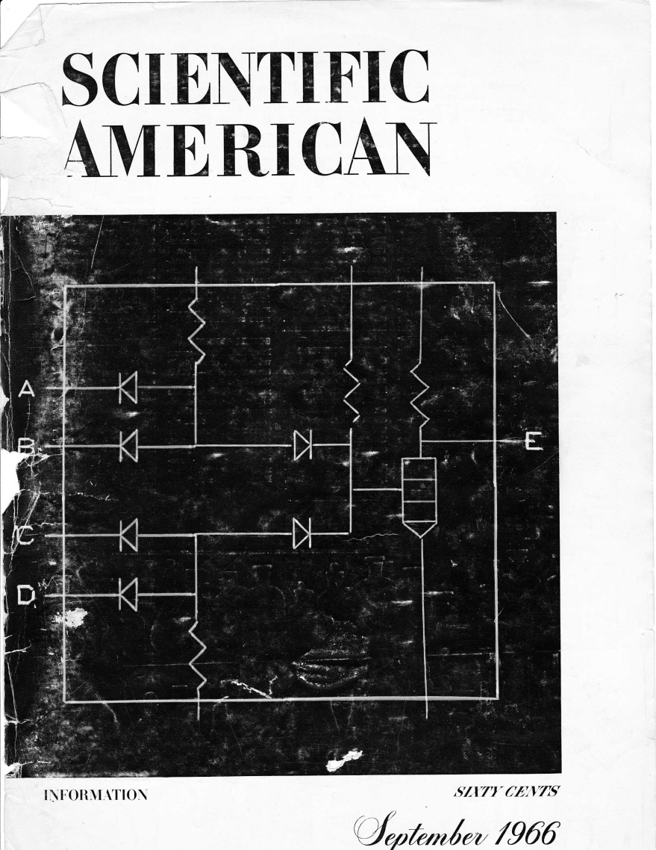
A New Passion
Notes:
Since I was not going to be a Scientist in Blue
I was searching for a new passion
In September 1996 this magazine appeared
It was all about computers
I was fascinated

Slide 5
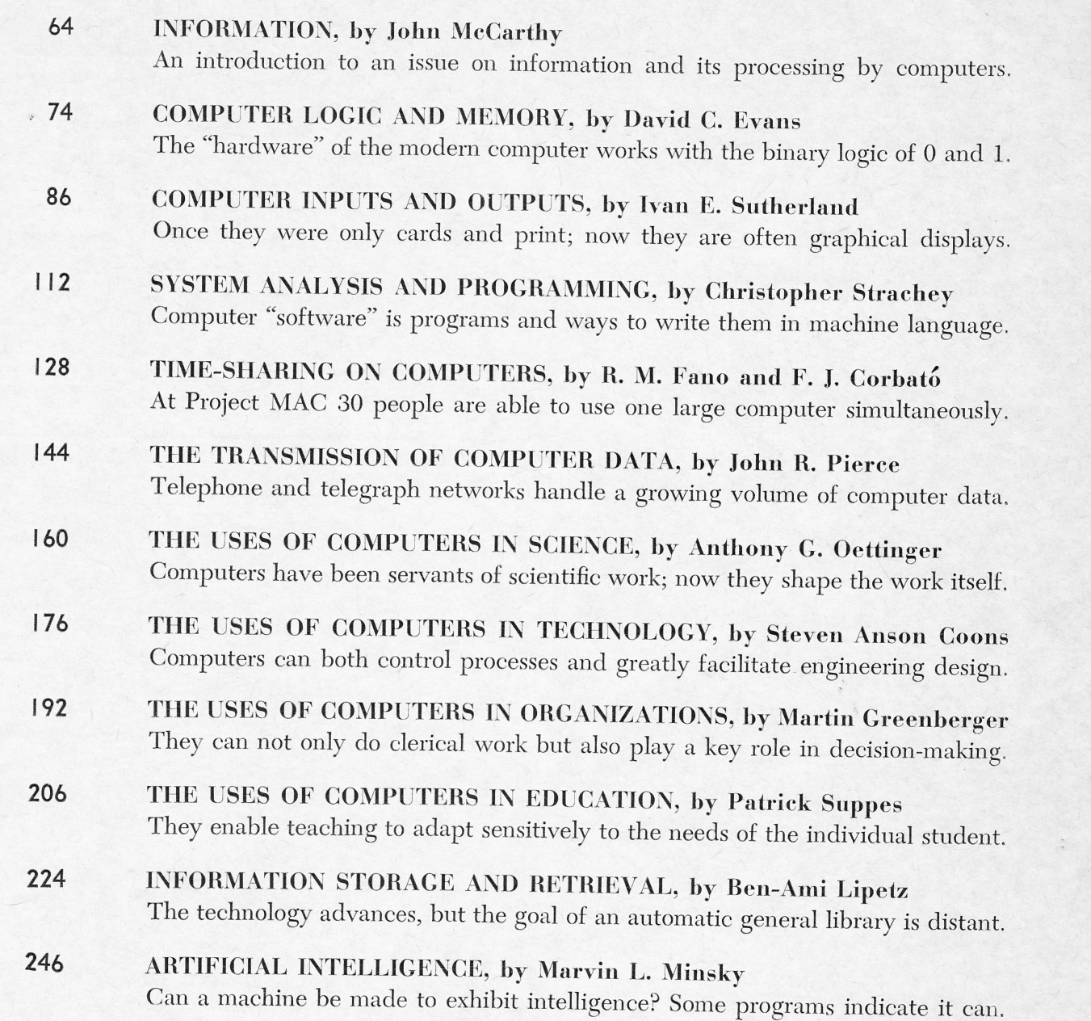
A World Of Possibilities
Notes:
This is the index of the magazine
Computer logic and memory
Computer inputs and output
Time-sharing on computers
The uses of computers in science
Artificial Intelligence
I would have changed my major if I could
But Virginia Tech did not have computer science major
I took the only computer course they had
It was in Fortran programming
Once I learned the basics of programming,
I knew this was my new passion
But I had to put it on the back burner until I finished college

Slide 6

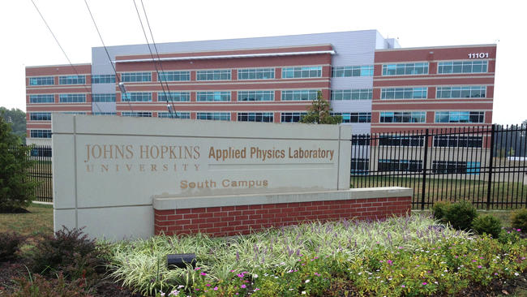
Applied Physics Laboratory
Notes:
The first job that I interview for was
The Johns Hopkins Applied Physic Laboratory
I only had a BS so
The job I was interviewing for was that of
What was called a “lab rat.”

Slide 7
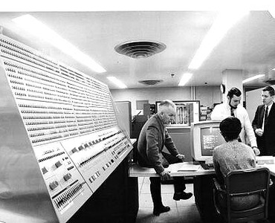
Computers!
IBM 360 Model 91
Notes:
Second floor window overlooking huge computer room
A bunch of computers including one huge one
Later learned was IBM/360 Model 91 – Super Computer
60 Nanoseconds, 6 Megabytes Memory, 32 Bit Bus

Slide 8
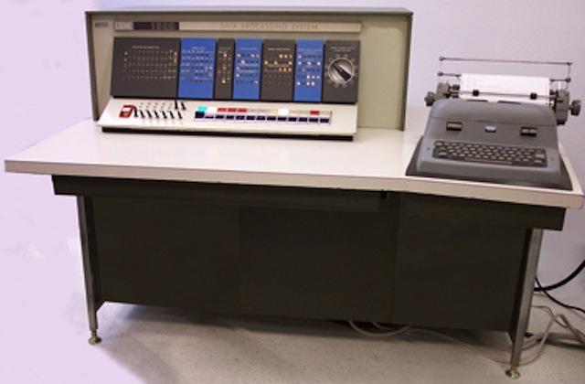
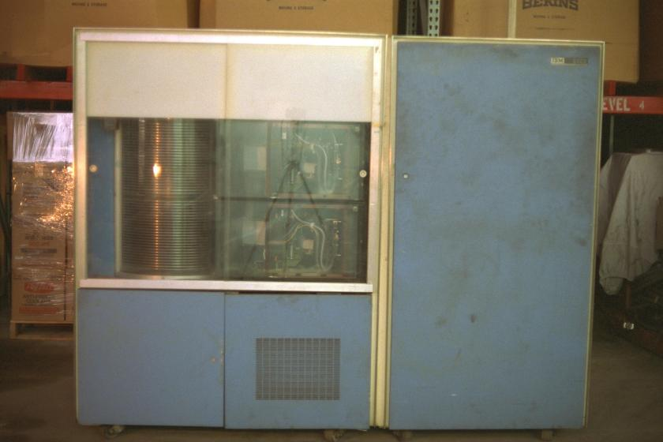
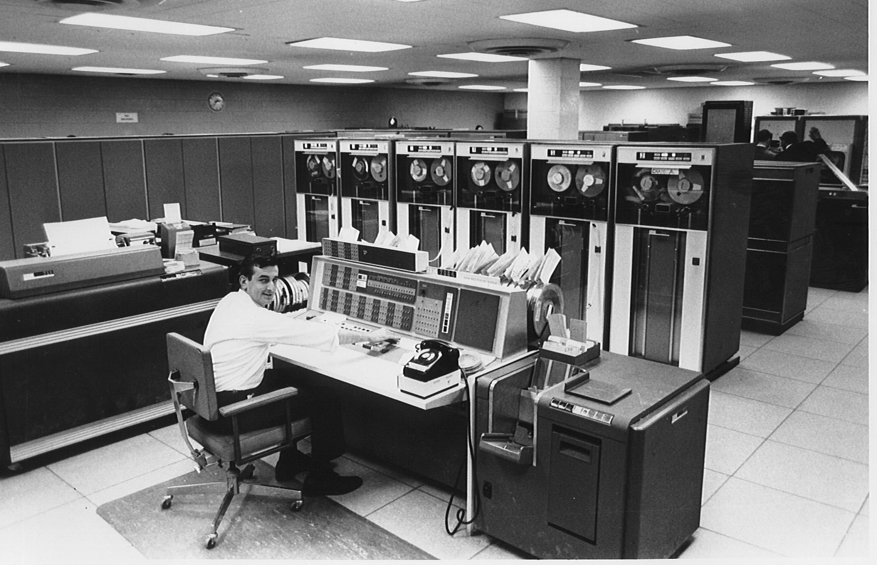
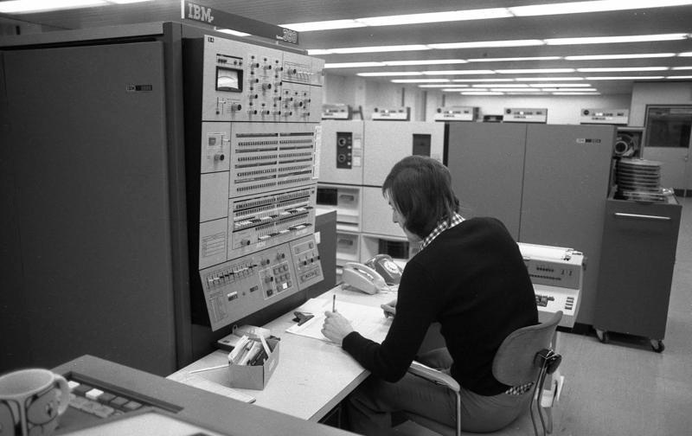
The Main Frames
IBM 1410
IBM 1302
IBM 7094
IBM 360/40
Notes:
But wait, there were more
1410 connected to
1302 – 58.5 Million Characters
Connected to
7094 – 2 microsecond cycle, 32k 32 bit words
I stood there wide eyed
Wanted to work with that
Offered operator...lower pay
I did not care about the pay, I wanted

Slide 9
Having Fun On The Job
I learned to operate all of those machines
Down time between starting and ending jobs
Learned to program each of the machines
Wrote check balancing programs and games
Ported a 7094 program to the 360/91
Wanted to do programming full time
Started reading the want ads
Got hired for an exciting programming job

Slide 10
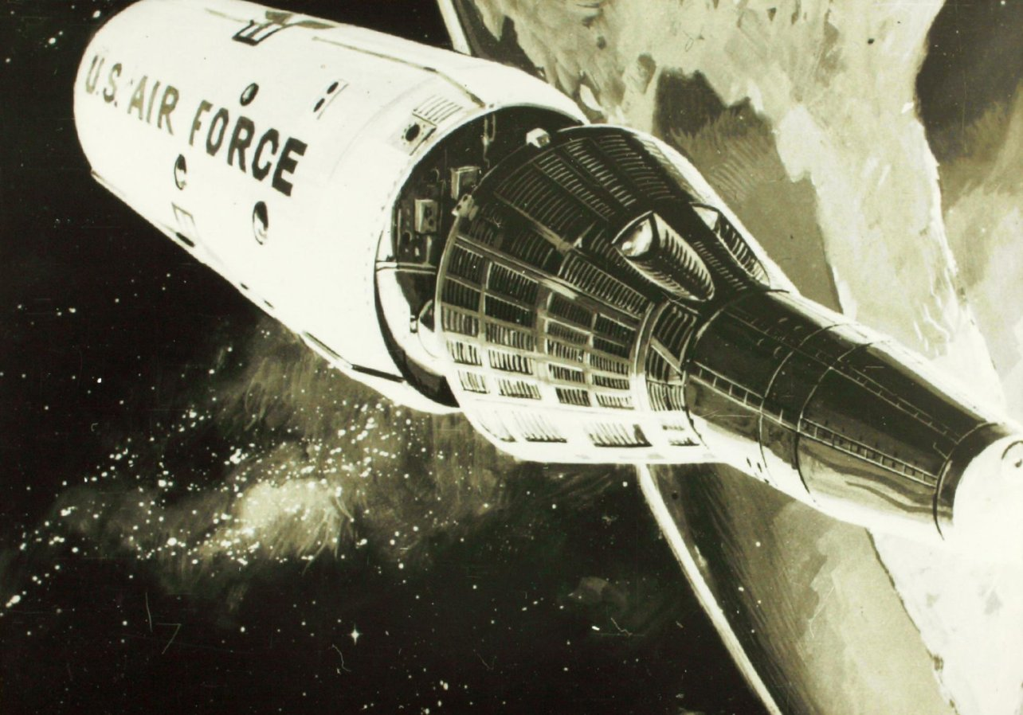
SPACE!
US Air Force Manned
Orbiting Laboratory
Notes:
Space Station
Spy in the sky
Gemini Space Capsule with hatch in heat shield
2 crew for 40 days
Lockheed, Sunnyvale, CA
March 1969
albuquerque, Restaurant, AF Major, cancel

Slide 11
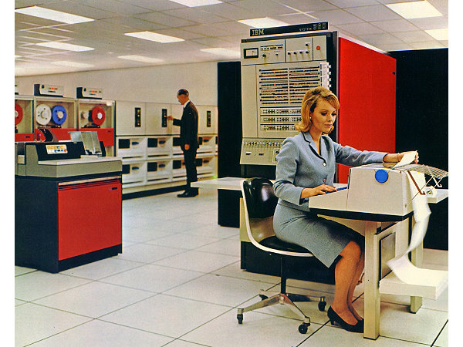
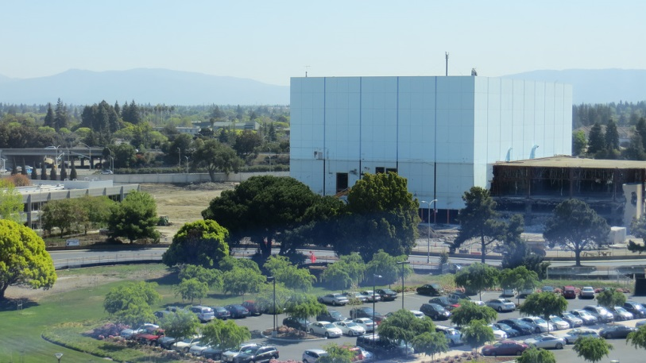
The MOL Control Center
IBM 360/65 (M65MP)
ARAND
Page Overlay Keyboard
The Blue Cube
Project Cancelled
June, 1969
Notes:
Unmanned satellites could do the same job, cheaper

Slide 12
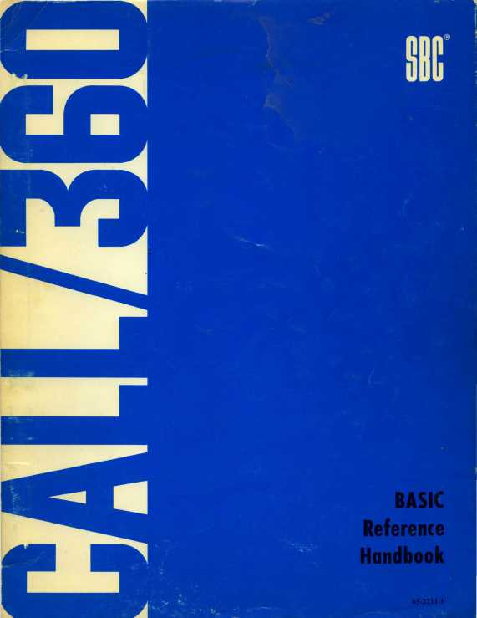
IBM SBC
Service Bureau Company
Computer Time Sharing
Basic, Fortran, PL/I
Hired to work
on the
operating system

Slide 13
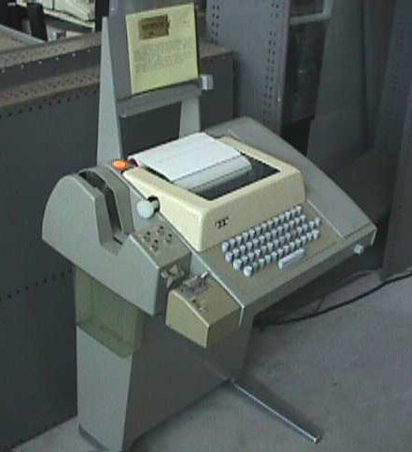
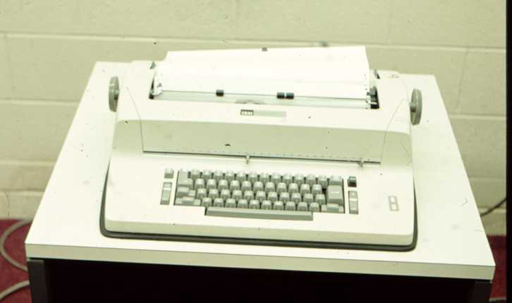
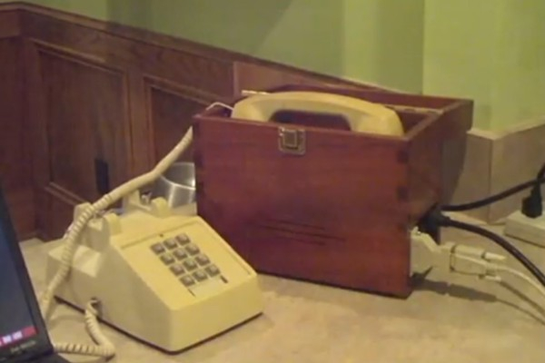
Call/360 Terminals
IBM 2741
ASR 33
Modem
Notes:
ASR 33 10 CPS
2741 13.5 CPS
Livermore Data Systems "Model A" Acoustic Coupler Modem
Had 2741 in my home

Slide 14
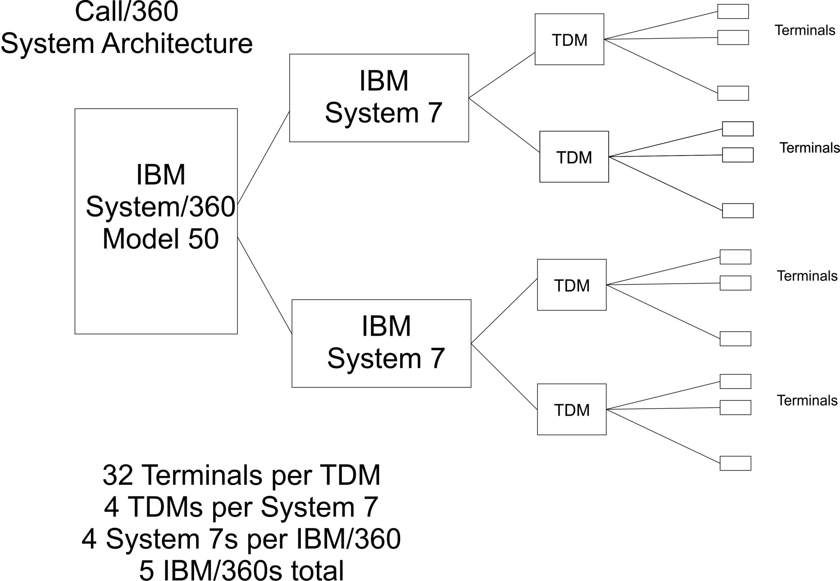
Notes:
on all aspects of system

Slide 15
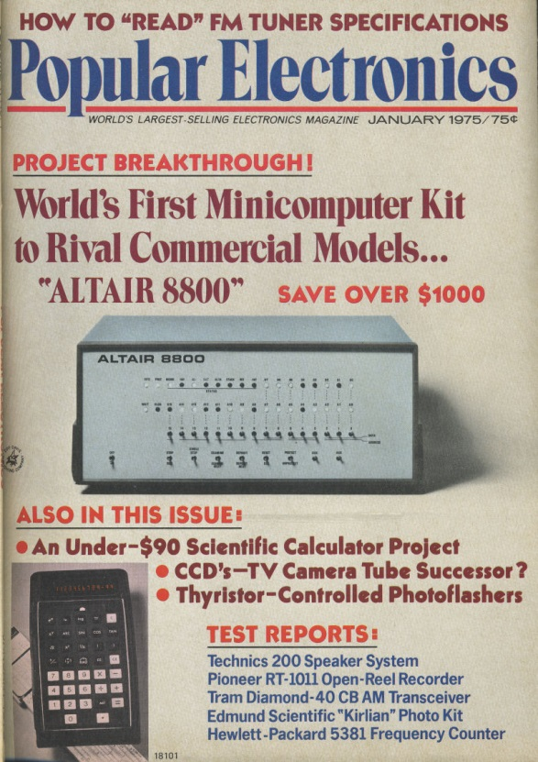
Microprocessors!
I WANT
MY
OWN
COMPUTER!
Notes:
January, 1975
$439 Kit
Does nothing
Have enter programs as ones and zero

Slide 16
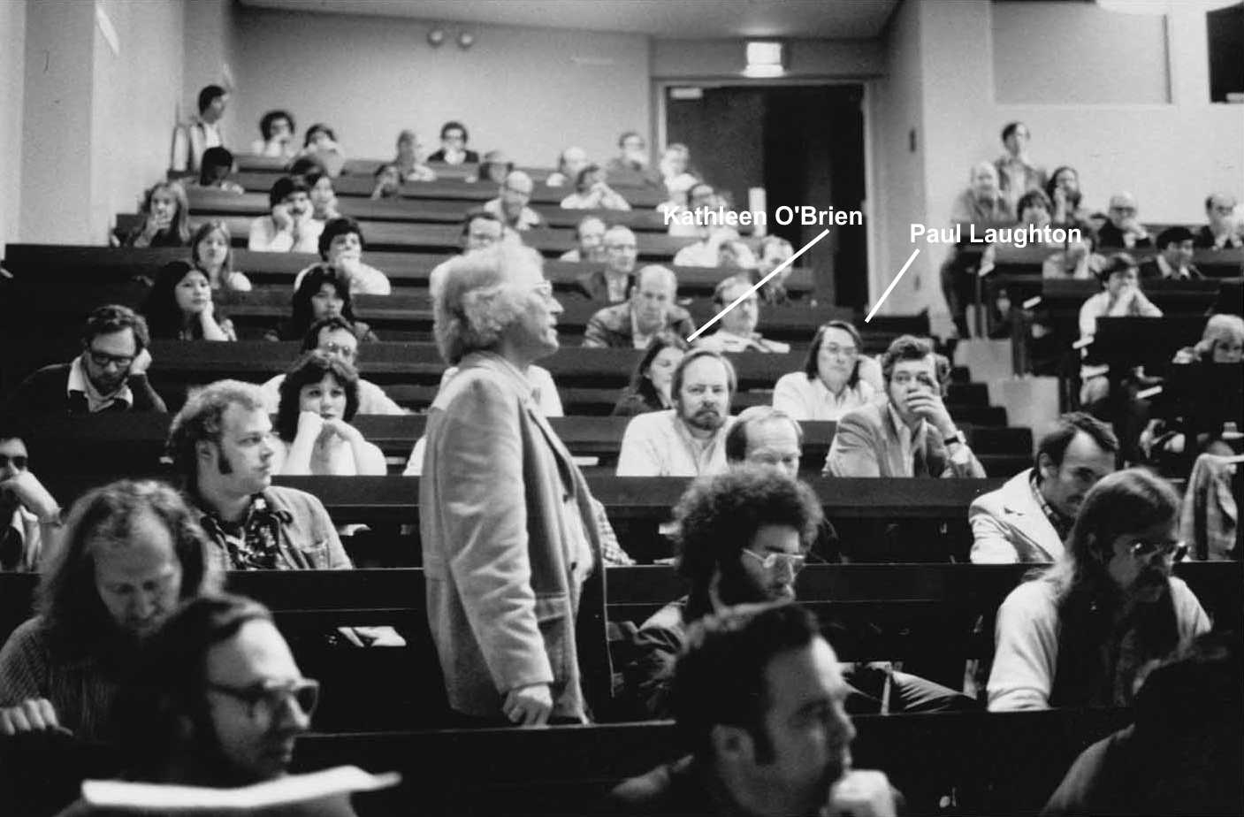
Homebrew Computer Club
Notes:
Gordon French
Lee Feldenstein (SOL, President HBCC)

Slide 17
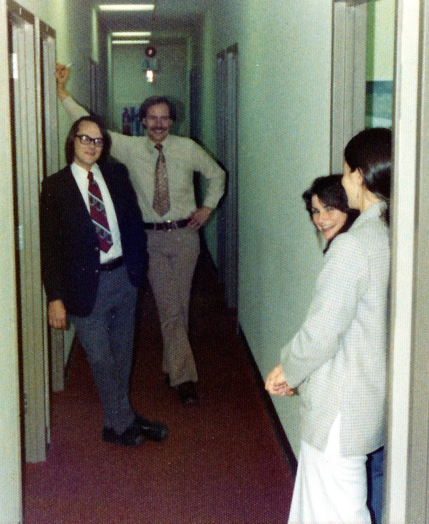
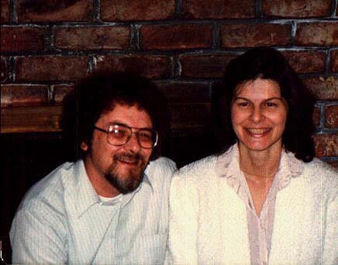
My Wife
Kathleen O’Brien

Slide 18
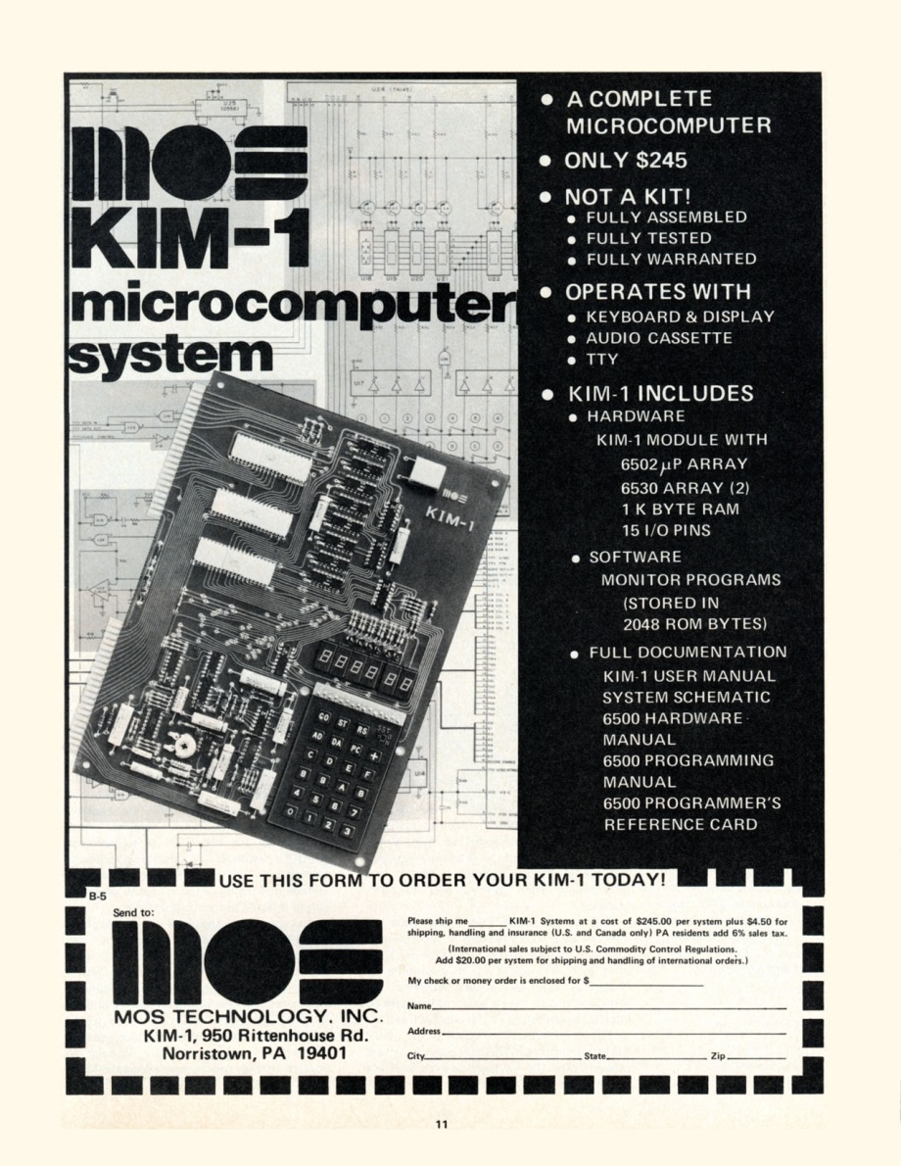
KIM-1
Notes:
1976

Slide 19
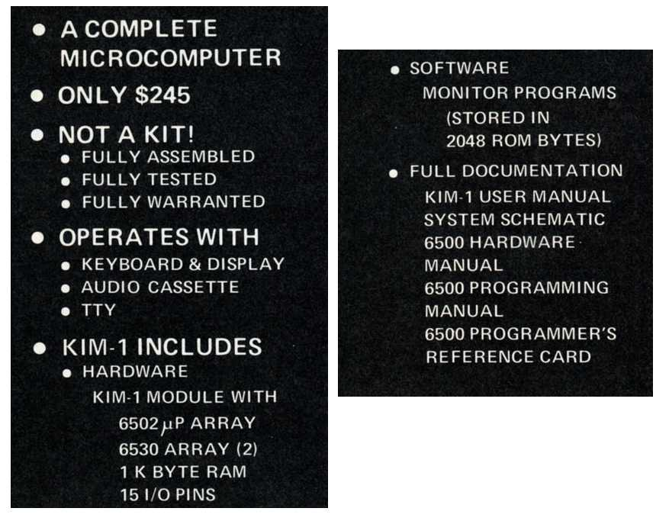
KIM-1 Features

Slide 20
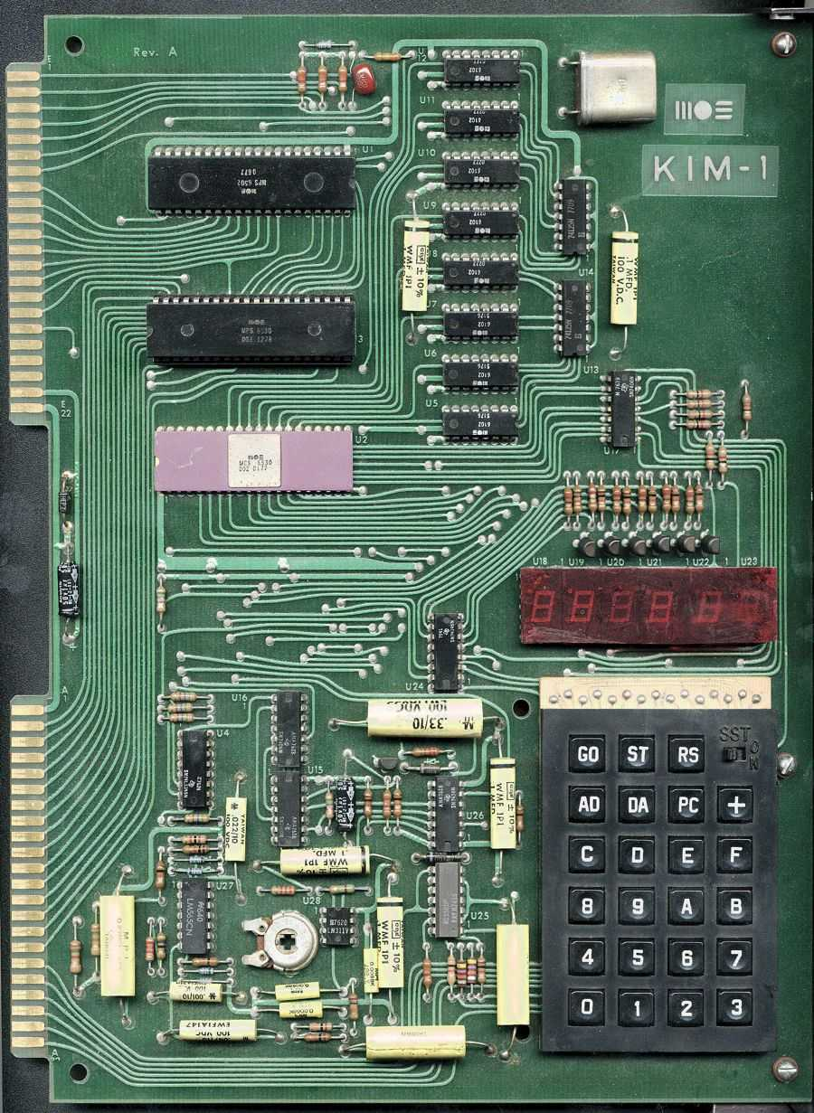
The KIM-1

Slide 21
Fun with the KIM-1
Hardware
Wire wrapped 3k of static memory
S100 bus
Added additional 48k of memory
Acquired a surplus CRT terminal
Notes:
Altair Bus became the S100 standard bus
The “S-100” name was coined by Harry Garland and Roger Melen, co-founders of Cromemco
IEEE-696
150 companies

Slide 22
Fun with the Kim-1
Software
Wrote 6502 assembler using IBM 360 assembler macros
Downloaded object code from Call/360 user ID
Wrote various utility programs
Wrote 6502 assembler that runs on a 6502
Started to write a Basic interpreter

Slide 23
Time For A Change
CDC
Personal Computers will kill time sharing
Really wanted to work with microcomputers
Starting looking at the want ads
Notes:
CDC 6600 Supercomputer
IBM announced the 360/92 that was to be faster than the 6600
People held off buying 6600 waiting for the 360/92
IBM could not get the 92 to work so they cancelled it.
CDC did appreciate the sales they lost to a fictional product
The brought an anti-trust suit against IBM
Settled for $80 Milllion
Plus SBC

Slide 24
SMI
Shepardson Microsystems Incorporated
Bob Shepardson (Shep)
Paper tape copy business
National Semiconductor IMP-16 Assembler
6502, Z80, 6800 Assemblers
Astral 2000 and Z80 Basic
Other products
Contracted to write a Basic for Apple
Notes:
Bearcat scanner
Atari game console (never sold)
Shep had one other programmer

Slide 25
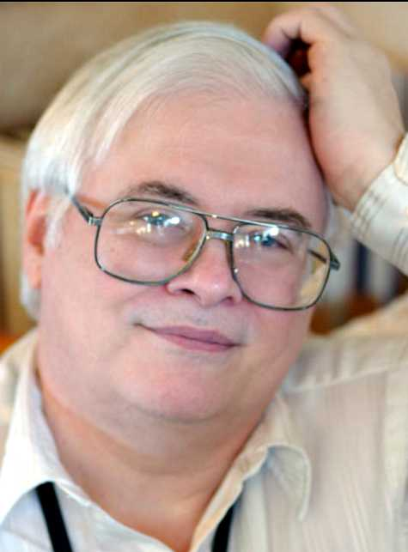
Bill Wilkinson
Genius
Russian Translator For USAF
Music Maven
Outstanding Programmer
Loved To Help Users

Slide 26
Apple Annie Basic*
Development Environment
6502 assembler code onto punch cards
Assembled on Shep’s IMP-16 cross assembler
Object output on paper tape
Woz created Apple II paper tape reader interface card
Read into a 48k Apple II
* Atari Basic
Notes:
Apple II delivered by Jobs

Slide 27
Apple DOS
The Beginning
Woz at SMI setting up the tape reader
Depressed
Had developed a floppy disk drive
Tight HW & SW schedule
I volunteered to do the DOS
Shep, Woz and Jobs agreed
Started working immediately
Apple Annie Basic put on hold

Slide 28
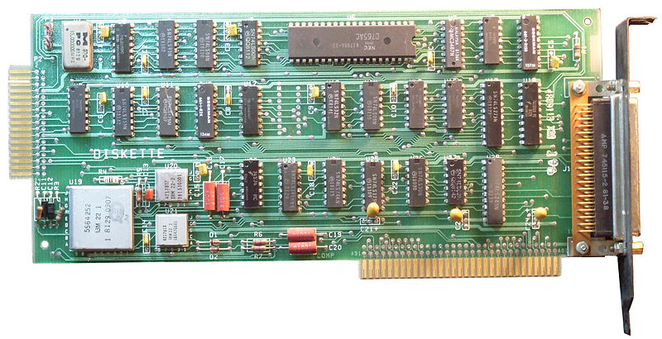
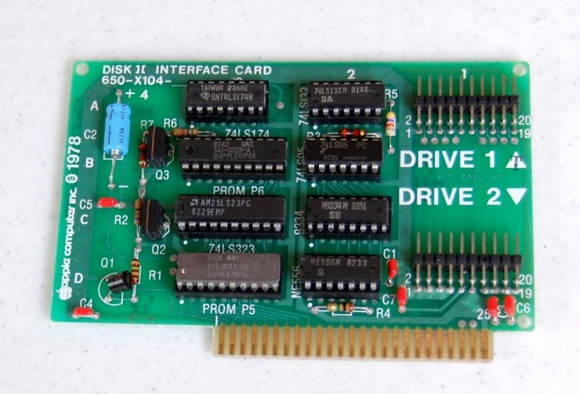
Apple DOS
The Hardware

Slide 29
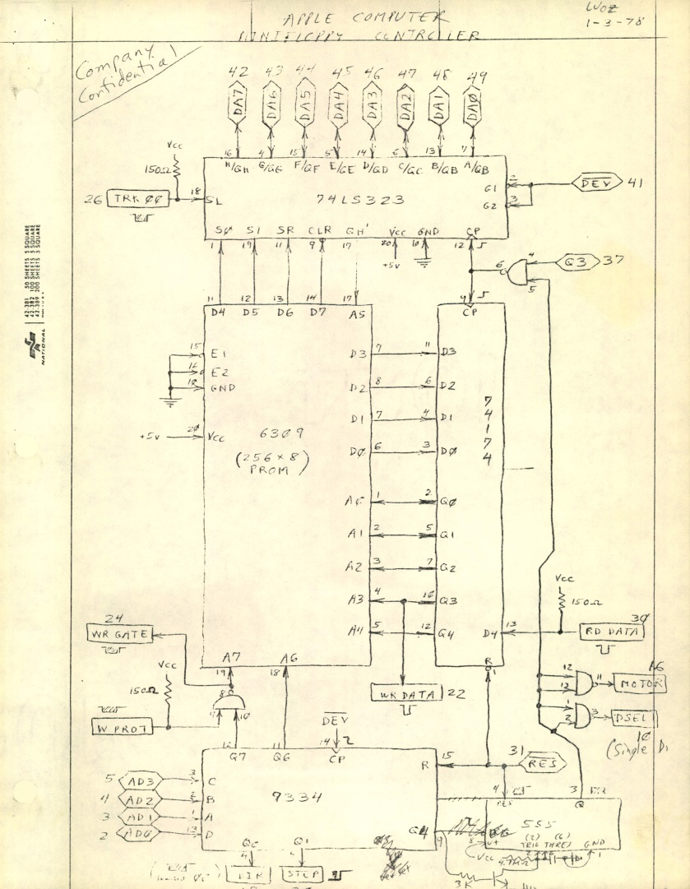
Apple DOS
Controller Schematic

Slide 30
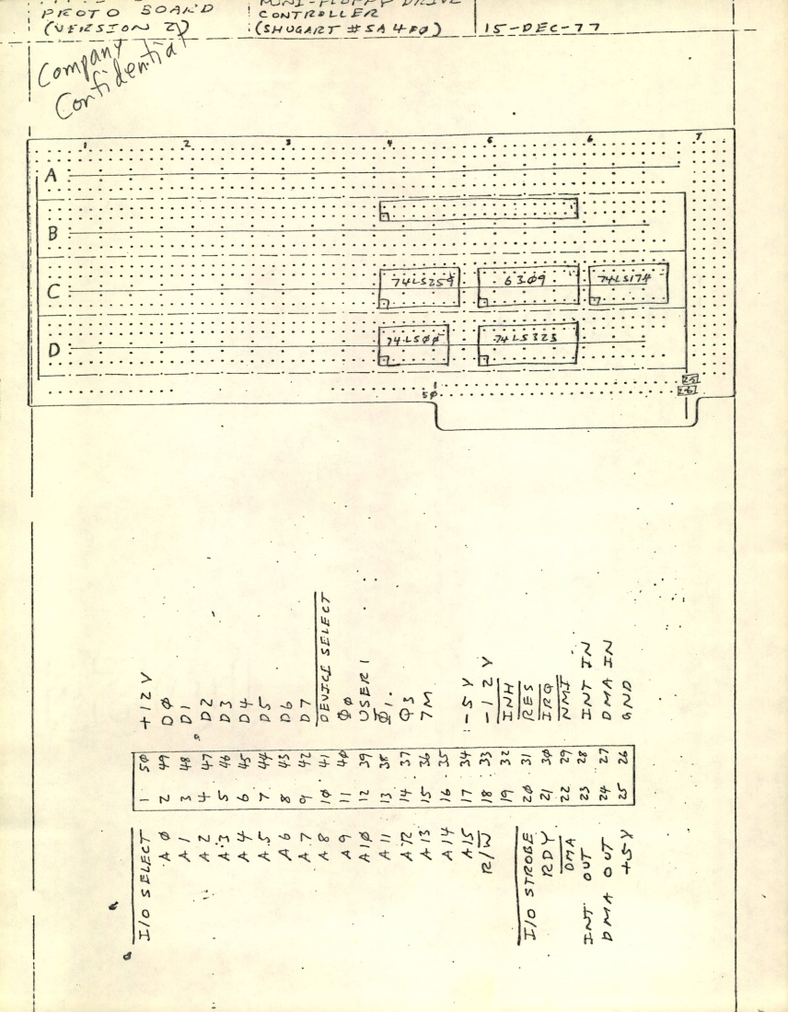
Apple DOS
Controller Breadboard

Slide 31
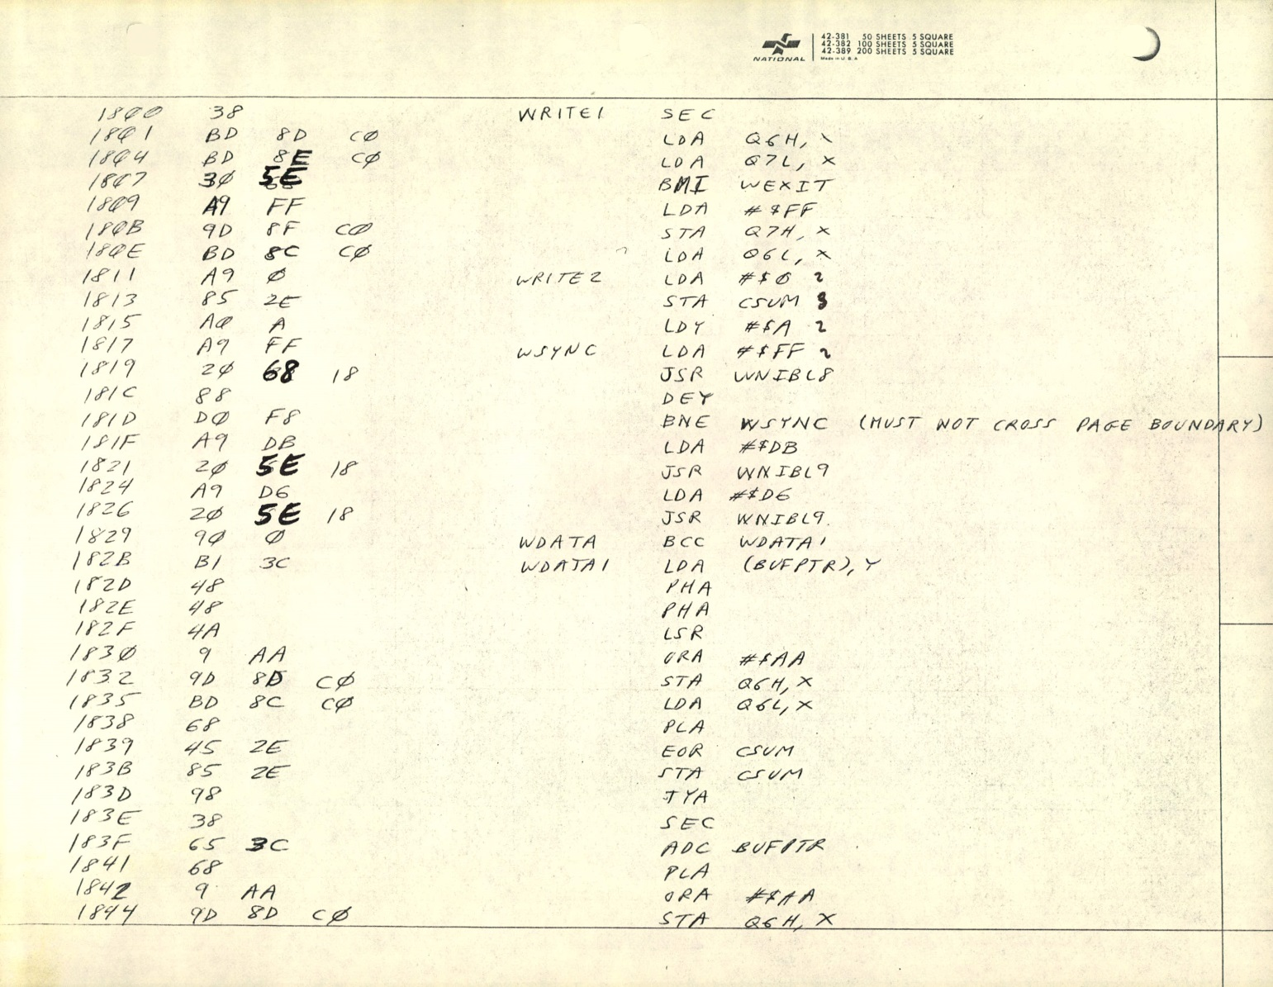
Apple DOS
Read Write Track Sector (RWTS)
Notes:
The timing of events in this code was critical
Must not cross page boundry
Later versions of apple with faster clock had to slow down while doing disk I/O

Slide 32
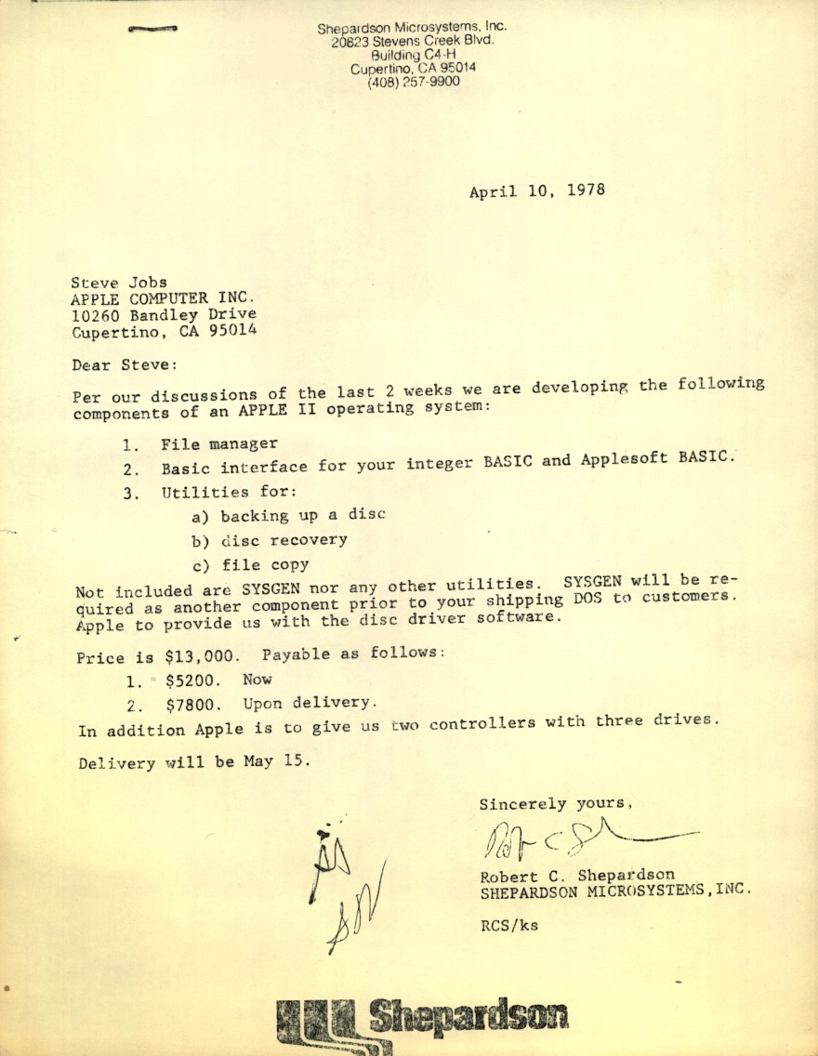
Apple DOS
The Contract
$13,000
Signed: April 10, 1978
Delivery: May 13, 1978
Signed by: Jobs, Woz, Shep

Slide 33
Apple DOS
Design
Keyboard
Monitor
Assembly
Language
Programs
Integer
Basic
Applesoft
Basic
Command Interpreter
Open
Close
Read
Write
Catalog
Init
etc
Data Control Blocks
File Manager
RWTS
Disk Drive
Notes:
DOS commands from running program were printed

Slide 34
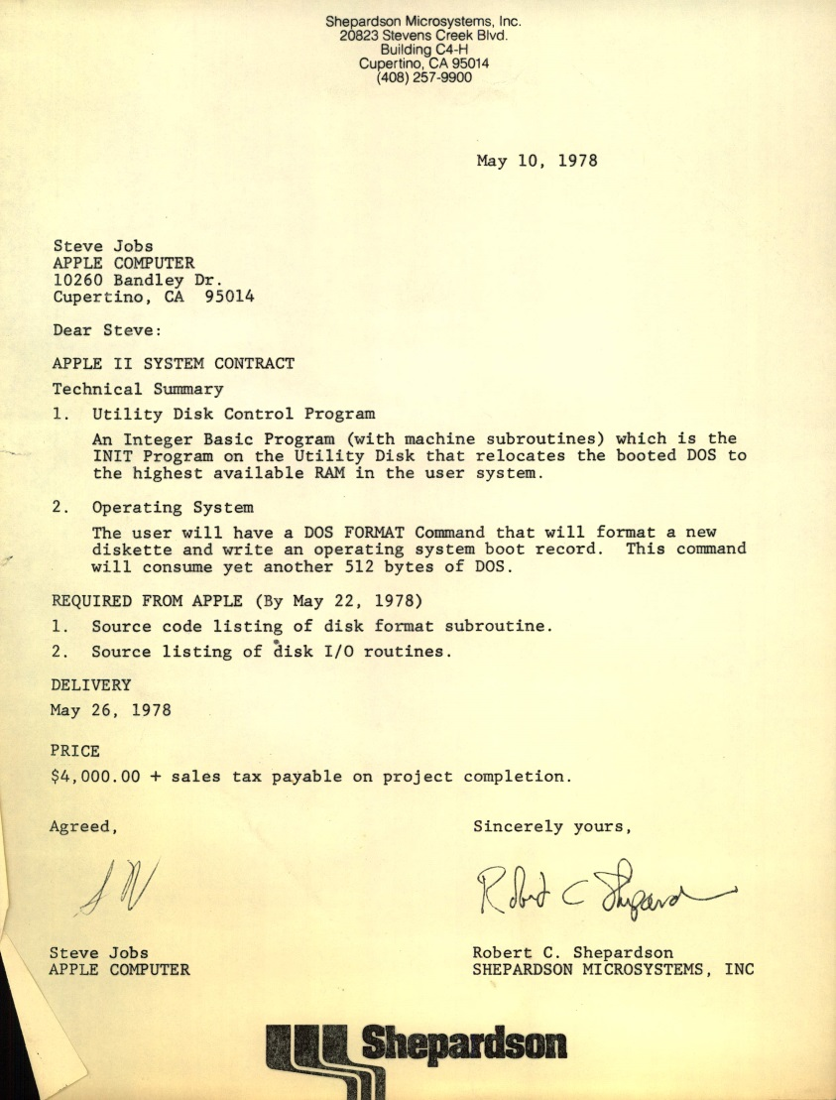
Apple DOS
Contract Addition
May 10, 1978
DOS Relocation
Boot Disk
$4000
May 26, 1978
Notes:
May 13 original deadline

Slide 35
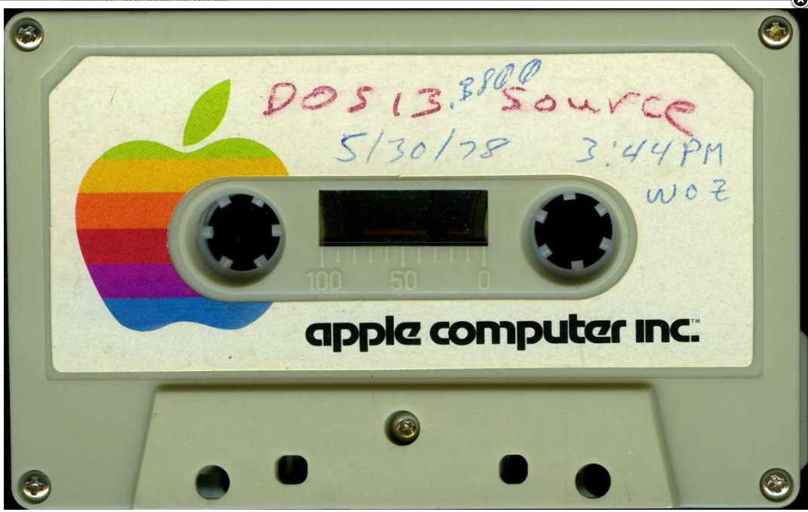
Apple DOS
Initial Delivery
Delivered On Schedule

Slide 36
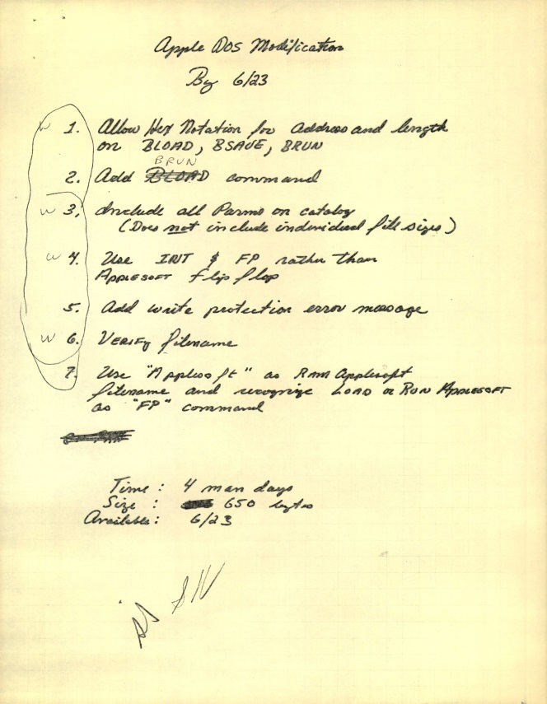
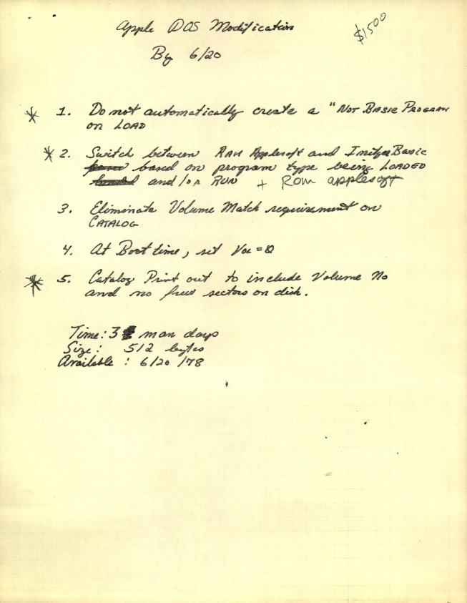
Apple DOS
More Changes
Minor Changes
$2,000
Due June 23

Slide 37
Apple DOS
No News Is Good New
Delivered changes by end of June
Resumed work on Basic
Shep had hired Kathleen O’Brien
Heard very little from Apple about DOS
July, August, September

Slide 38
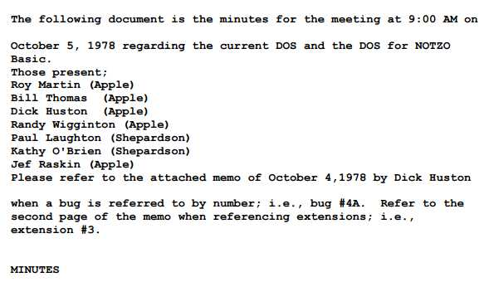
Apple DOS
October Meeting
Kathy and I called to meeting at Apple
DOS bugs
Issues with Basic
Meeting Minutes
Randy Wiggington
Notes:
Give details

Slide 39
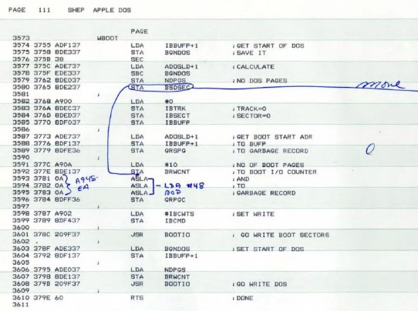
Apple DOS
Final Act
Final Delivery – 10/6/78
Marked up listing fixing bugs
Source on diskette
Dick Huston took over
I Never touched it again

Slide 40
Apple DOS
Design
Keyboard
Monitor
Assembly
Language
Programs
Integer
Basic
Applesoft
Basic
Command Interpreter
Open
Close
Read
Write
Catalog
Init
etc
Data Control Blocks
File Manager
RWTS
Disk Drive
Notes:
Here again is the design of DOS
There is something missing here
Because Apple did not document it

Slide 41
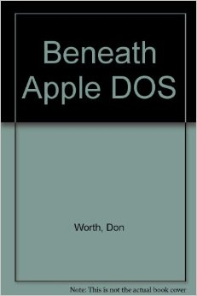
Beneath Apple DOS
Explains how to use DOS
from assembly language programs
I had asked Apple permission to write
this type of book
Apple refused.
Don Worth claims he disassembled DOS
And reverse engineered it.
He had to have had a listing.
Names I used like VTOC, IOCB, DCB, etc

Slide 42
Apple Annie Basic
No Specifications other than a “Simple Basic”
Jeff Raskins assigned to write manual
Jeff wanted a very rich and powerful Basic
Projected size > 32k
Jeff called it NOTZO Basic

Slide 43
NUTZO BASIC
No one at Apple responsible for the Basic
Apple told us they would fix the problem
John Couch hired as software VP
John’s solution: Cancel the project
Which was fortuitous for us…

Slide 44
Enter Atari
Atari starting working on Collen and Candy early 1979
Planned to use Microsoft 6502 Basic
By late summer ‘79, MS Basic was 12k
Too big to fit into 8k cartridge
Wanted to show at January, 1980 CES
Came to SMI for help

Slide 45
Atari Proposal
SMI offered a new, custom Basic
Plus a Disk File Management System
Atari agreed mid October, 1979
Delivery: April 6, 1979
$1000 Bonus/Penalty for every week early/late

Slide 46
Atari Basic
Work Begins
Apple Annie Basic transformed into Atari Basic
Development testing done on Apple II
Development Team
Paul Laughton – Project Lead
Bill Wilkinson – Designed Floating Point
Kathleen O’Brien – Implemented Decimal Arithmetic
Paul Krasno – Implemented Transcendental Functions

Slide 47
Atari Basic
Features
Tokenized
Source text not retained
Decimal Arithmetic
DOS well integrated
Sound, graphics, paddle commands

Slide 48
Atari FMS
Modified Apple DOS
No need for the Apple command interpreter
128 byte sectors rather than Apple’s 256 byte
I/O done via Atari CIO

Slide 49
Atari Basic & FMS
First Working Delivery
Delivered: December 22, 1978
In time for January, 1980 CES
About 12 weeks development time
$12,000 Bonus

Slide 50
Atari Basic & FMS
Delivered but not finished
Fix Bugs
Review manuals
Modify FMS for Atari 815 Dual Density Drives

Slide 51
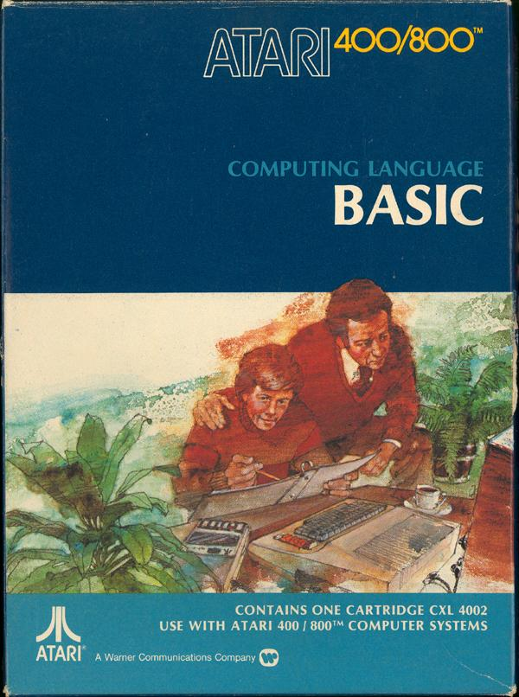
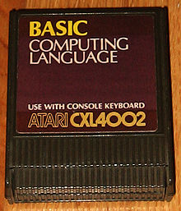
Atari Basic
As Sold

Slide 52
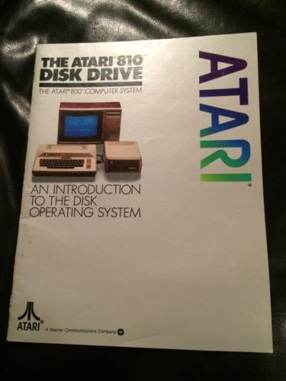
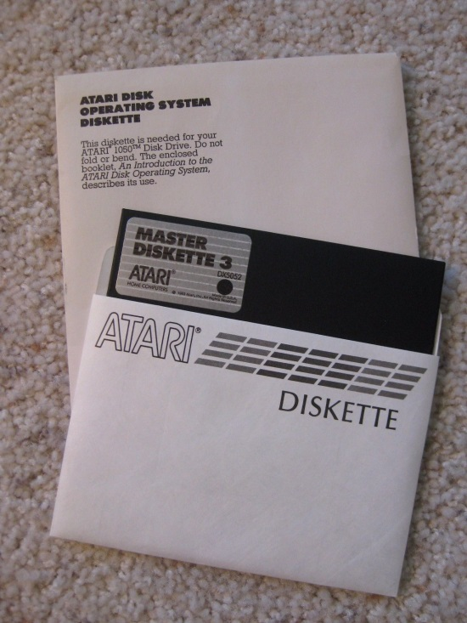
Atari FMS
As Sold

Slide 53
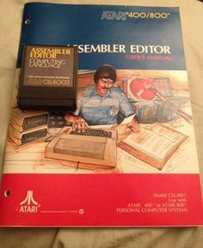
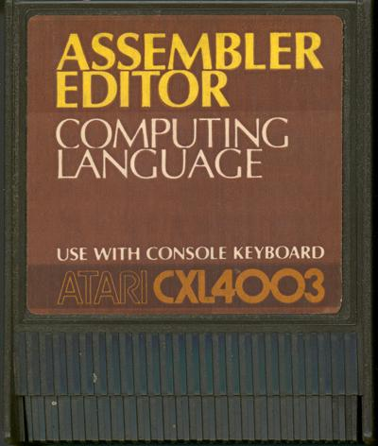
Atari Assembler Editor
Author: Kathleen O’Brien

Slide 54
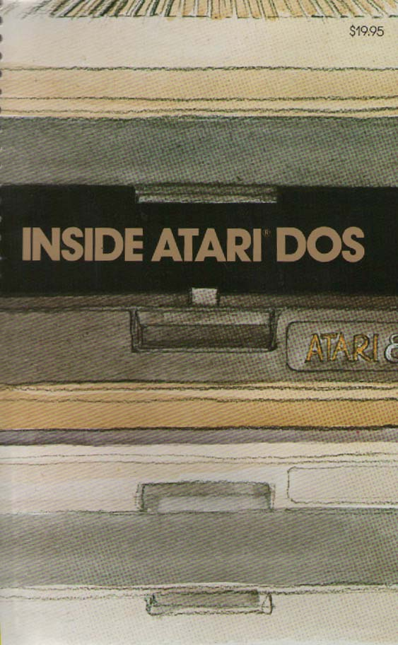
Inside Atari DOS
COMPUTE! Books
Bill Wilkinson
Paul Laughton
Provides Listing
And
Detailed Explanations

Slide 55
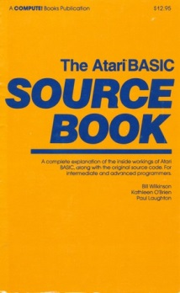
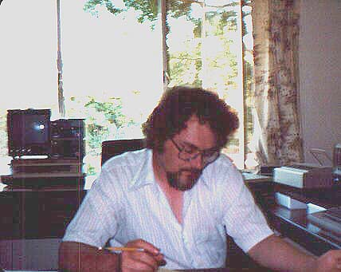
Basic Source Book
COMPUTE! Books
Bill Wilkinson
Kathleen O’Brien
Paul Laughton
Provide Listing
And
Detailed Explanations

Slide 56
Optomized System Software
Bill Wilkinson bought rights to Atari software from SMI
Incorporated OSS
Created CP/A for Apple
Ported Atari Basic to Apple as Business Basic
Ported Assembler/Editor to Apple
$124.95

Slide 57
OSS
Ported everything to Atari
Enhanced versions of Basic, Basic+, Basic++
Prolog for Atari
Bill wrote monthly column in COMPUTE! Magazine

Slide 58
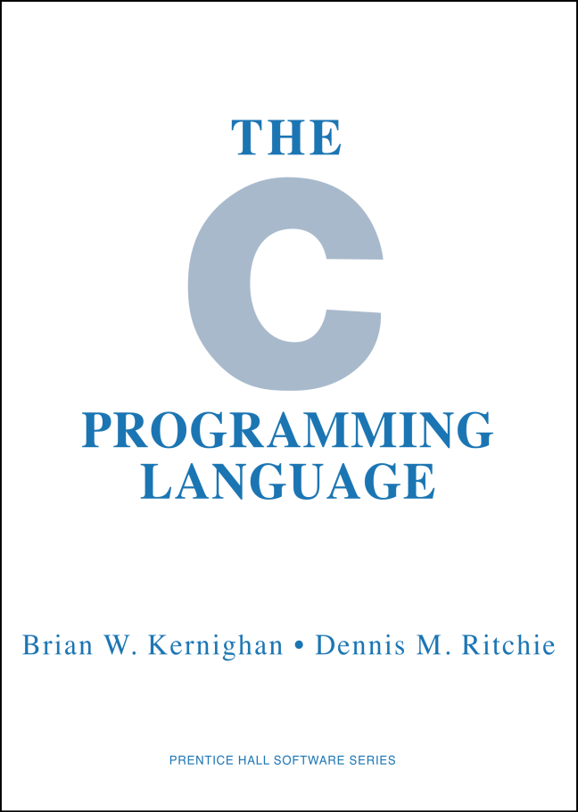
Cromemco C Compiler
I had no knowledge
of C when I started
Developed using Whitesmith’s C
On a PDP 11
Precompiler – Paul Karsno
Main Compiler – Paul Laughton
Z80 code generation – Bill Wilkinson

Slide 59
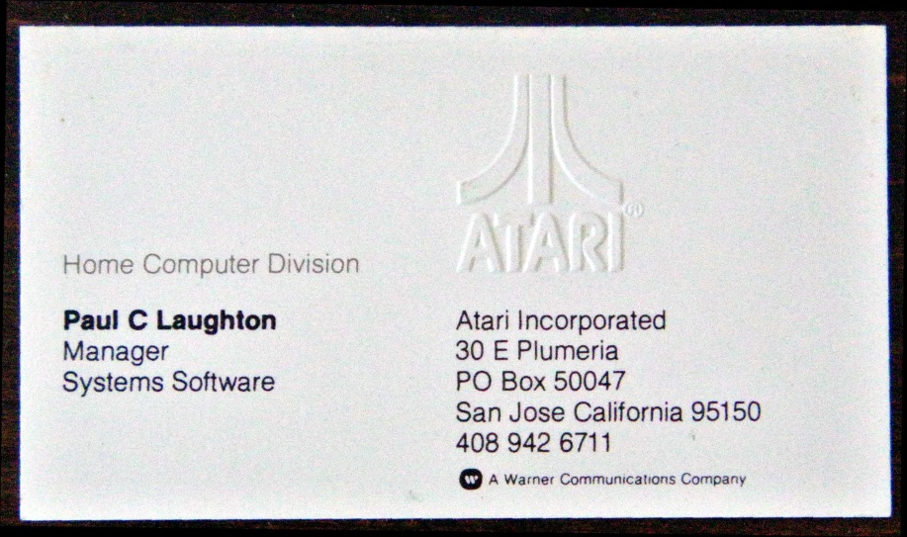
The 80s
Atari
Shep was loosing interest in the business
Kathleen went back to SBC
SMI no longer any fun
Atari made me an offer that I could not refuse
Entered the management track

Slide 60
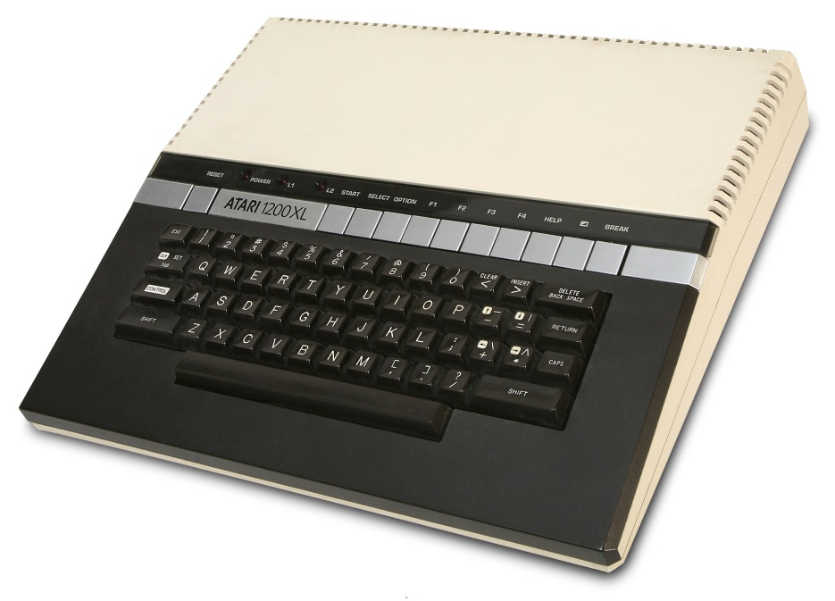
The 80s
Atari 1200 XL
I thought the 1200 XL was beautiful
Sweet 16
Managed system software team
Part of the computer design team
Four function keys
Help key
Self test
Screen, memory
Sound
Keyboard
The Atari Community thought it was and Edsel

Slide 61

The 80s
Fox Video Games
Atari was in trouble
Offered job at Fox Video Games
Took 6 Atari engineers with me
Game development as an engineering task
One game, many machines
Games based upon Fox Properties
Fast Eddie, Porky’s, Alien, M*A*S*H, etc.
Give My Regards To Broad Street
Paul McCartney
$18 Million Dollars
Shut down

Slide 62

The 80s
Voysys
An OEM voice mail provider
One of the founders
Scripting language for VM applications
VoyScript
Lots of turmoil and infighting
Resigned

Slide 63






Logitech

Slide 64

Dycam Model 1
Meeting with Dycam
376x240 Pixels
8 Bit Grayscale
32 images
Logitech made an offer

Slide 65

Logitech Fotoman
Logitech paid $1,000,000
Developed software for PC and Mac
Market: Relators, Insurance + anyone needing fast turn around
OEM versions for medical use
Company reorganized
Functional units -> Business Units
Director, Camera Development
Started design of
a Color Fotoman
Notes:
Fotoman used a black and white TV camera sensor
We decided we could make a color Fotoman using a color TV sensor

Slide 66


Color Camera
Image Sensors
Array of filtered B&W photo sensors
(Bryce) Bayer’s Pattern
Repeating 2x2 pattern
2 Green, 1 Red, 1 Blue
Demosaicing
Fotoman Color image Sensor
CYGM
Notes:
Kodak
1976
Match sensitivity of human eye
Raw image

Slide 67
Color Fotoman
While working on color Fotoman
Two guys from Kodak
Digital camera prototype
I was interested
I visited Kodak and Chinon in Japan
24 bit color, 768x512 pixels, 48 images
I told Kodak we wanted to market the camera

Slide 68

Logitech Pixtura
My team developed a complete set of specifications
Did the industrial design
But…Kodak was not responding to my commitment
Learned Kodak could only sell to two customers
They already has Apple and Compaq

Slide 69

Logitech Pixtura
Compaq cancelled!
Contracted with Kodak
Design work began in earnest
Lots of time in Japan

Slide 70

Kodak DC40
Work was proceeding smoothly, until …
My management said Logitech could no longer afford the project
Informed Kodak in an interesting meeting.
A few days later Kodak made a proposal
Kodak would also sell the Pixtura as the DC40
Logitech would not pay any further development cost
Kodak would pay Logitech a royalty
I would continue as project manager
Logitech agreed

Slide 71

Digital Camera Twins
Kodak sold many more of their camera
Kodak sent royalty checks directly to me
Royalties more than paid for Logitech development expenses

Slide 72

Logitech PageScan Color
Design
Logitech no longer interested in digital cameras
Design a sheet fed scanner
Three LEDs, Red Green, Blue
Fiber optics light pipe to photo sensors
Very low power
USB interface
USB Power – No wall wart
Notes:
Three photo sensors per pixel – RGB

Slide 73

PageScan
Windows 98
Windows 98 has robust USB support
PageScan driver to be included in W98
Microsoft tests drivers
MS thought PageScan showed power of USB
Invited me to speak at WinHEC 97

Slide 74

PageScan
Software
I wanted easy to use but powerful software
I did not like the way the SW design was going
Hired Alan Cooper’s company to do the design
Cooper’s design was everything I wished for
Easy to use but powerful

Slide 75


Slide 76


Alan Cooper
Father of Visual Basic
World class product designs
Author of several books
COOPER.COM
Notes:
Personas

Slide 77
Flashpoint
Steve Jobs returns to Apple
Eliminates all non computer products
Camera product development group
Spun off from Apple and named Flashpoint
Flashpoint’s Product
Camera Operating System for camera OEMs
Customer adapts OS to their camera
Scripting language
Notes:
While I was working on Pagescan,
In 1997

Slide 78

Flashpoint
Flashpoint looking for Engineering VP
Building Software for the Kodak DC-260
Kodak’s team – same people as DC40 team
Kodak suggested me as the VP

Slide 79

Flashpoint
Code base was awful
Impossible for customer to DIY
Every project was custom built by FP
Could not get second round of funding
I retired
FP exists today as a patent holding company
Notes:
I had been thinking about retiring

Slide 80

BASIC! For Android
The Beginning
Code Camp – Foothill College
October, 2010
Introduction to Android Application Development
Created Expression Processor App
Transformed into BASIC!
First released in December, 2010
Free
Richard Feynman Observator
RFO
Notes:
My wife was teaching computer science at Foothill College

Slide 81
BASIC! For Android
Grows
New releases every week
Connecting to new Android APIs
User forum started in June, 2011
Feedback from users
Users interacting
Today: 1780 users, 31,000 Posts

Slide 82

BASIC! For Android
User Manual
Read Me Text File
Word Document
Professional technical writer
Today has 238 Pages
Notes:
Original documentation

Slide 83


BASIC! For Android
Stand Alone Apps
Most of Android’s features
accessible from BASIC!
Can Transform BASIC! program
into a stand alone APK

Slide 84

BASIC! For Android
Community Development
Open Source
GNU General Public License
Put on GitHub in October, 2013
User Development Team
97,000 Downloads
4.5/5.0 Rating

Slide 85
Today
Apple DOS Oral History – August, 2013
Given Private Tour by CHM Chairman Of The Board
Loved the place
Took docent training
IBM 1401 Demonstrator
Wrote Tiny Basic for the 1401
What’s next?

Slide 86
Do what you love,
Love what you do,
And you will love your life
paul@laughton.com
www.laughton.com/vcf16.pptx

