Slide 1
A Techman’s adventures in Silicon Valley
Creating Apple DOS 3.1, Atari Basic, Digital Cameras and more.
Notes:
American start speeches with a joke
Spent some time in Japan
Learned that Japanese start their speeches with an apology
I am going to pay homage to both cultures
I humbly apologize to you for not starting this speech with a joke

Slide 2
Career Timeline

Slide 3
My Passion
Do what you love,
Love what you do,
And you will love your life
Notes:
My father, an electronics engineer and a geek like me, once told me
I have tried to live by this rule
This means that I needed to choose a career that I loved
My first passion was to be an Air Force Officer

Slide 4
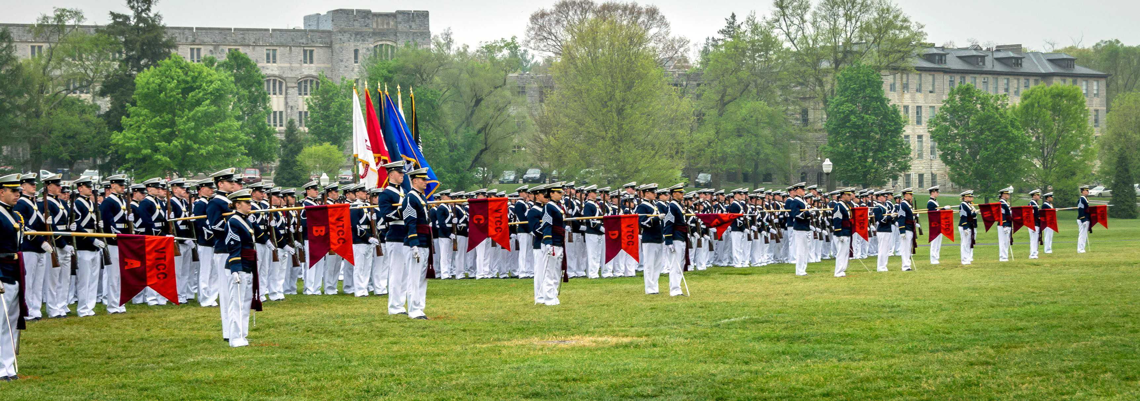
VPI
AFROTC Cadet Class of ‘67
Notes:
I chose Virginia Tach majoring in physics because I wanted to become
What the Air Force called a Scientist in blue
Unfortunately, I failed the Air Force physical

Slide 5
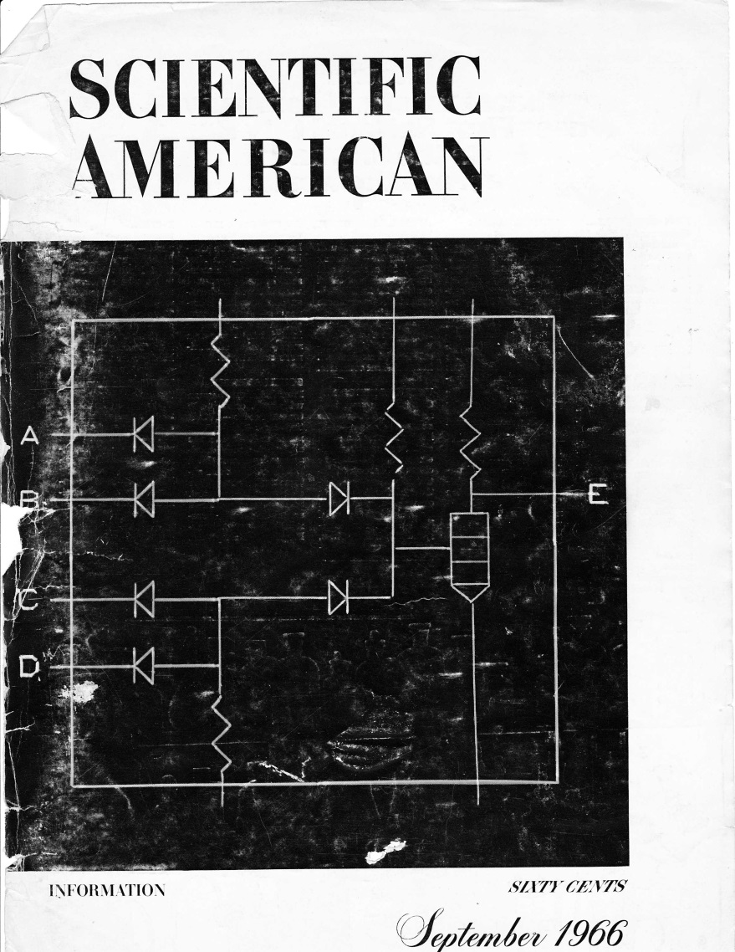
Computers!
Notes:
Since I was not going to be a Scientist in Blue
I was searching for a new passion
In September 1965 this magazine appeared
It was all about computers
I was fascinated

Slide 6
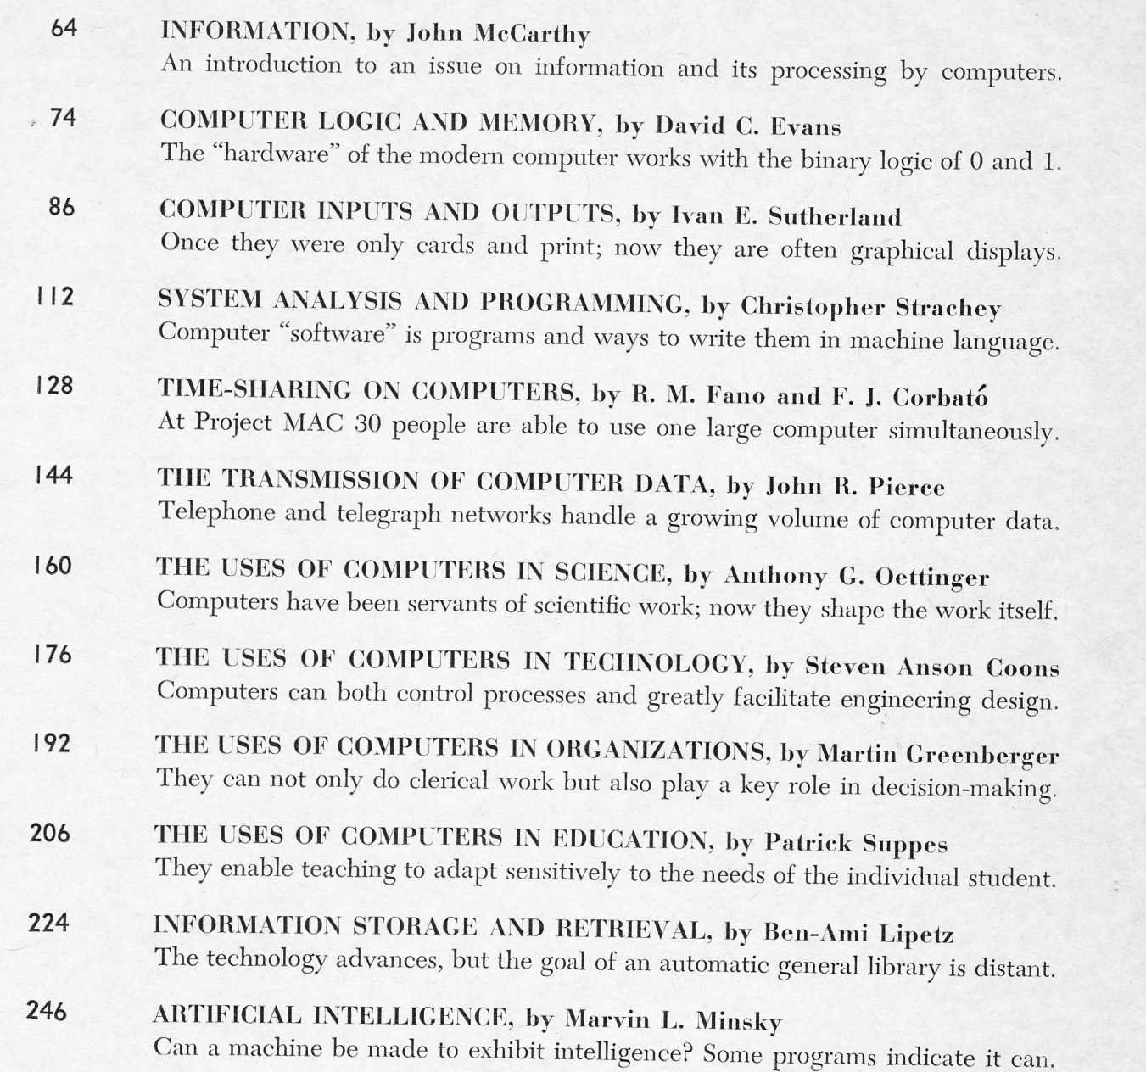
A World Of Possibilities
Notes:
This is the index of the magazine
Computer logic and memory
Computer inputs and output
Time-sharing on computers
The uses of computers in science
Artificial Intelligence
I would have changed my major if I could
But Virginia Tech did not have computer science major
I took the only computer course they had
It was in Fortran programming
Once I learned the basics of programming,
I knew this was my new passion
But I had to put it on the back burner until I finished college

Slide 7
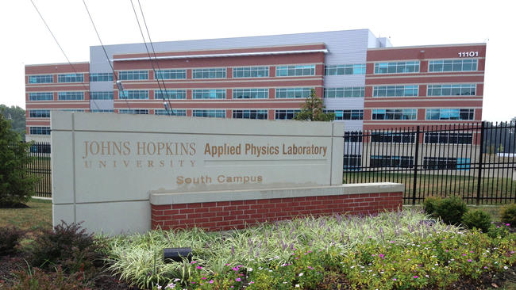
Applied Physics Laboratory
Notes:
My first job
The Johns Hopkins Applied Physic Laboratory Computer Operations Center

Slide 8
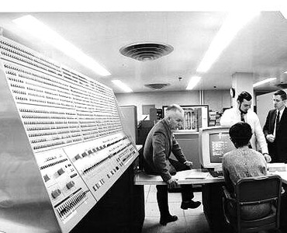
Computers!
IBM 360 Model 91
Notes:
They had very large computer center
This was IBM/360 Model 91 – a Super Computer
60 Nanoseconds, 6 Megabytes Memory, 32 Bit Bus

Slide 9
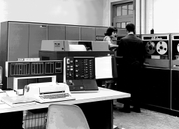
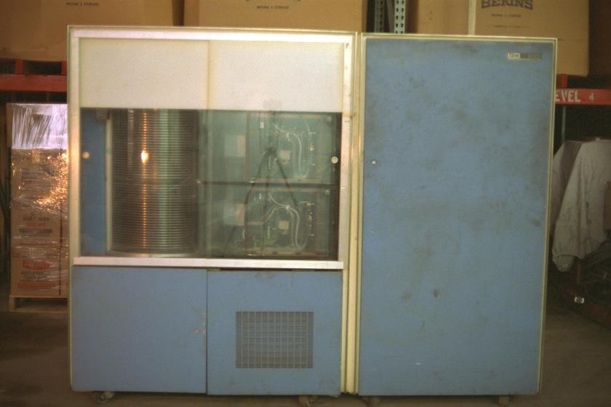
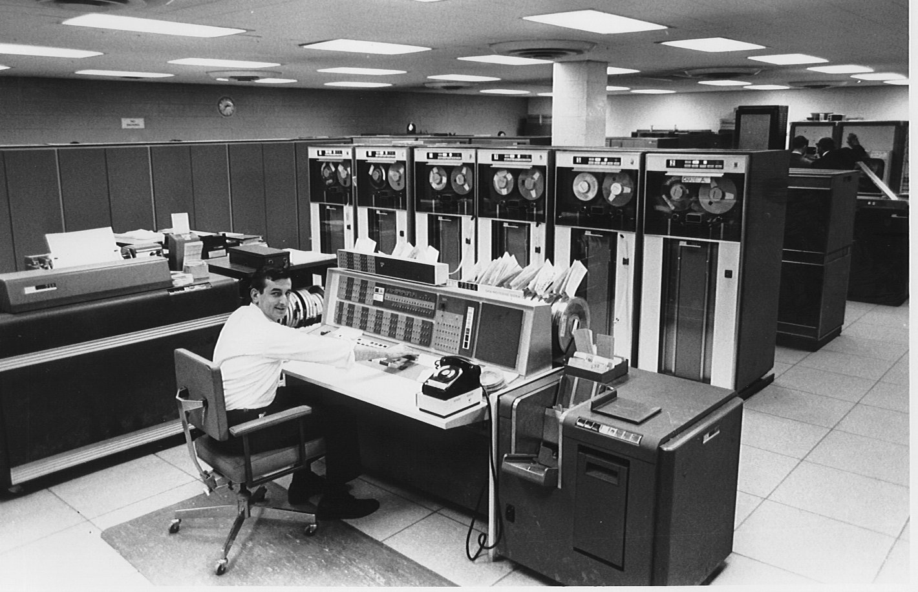
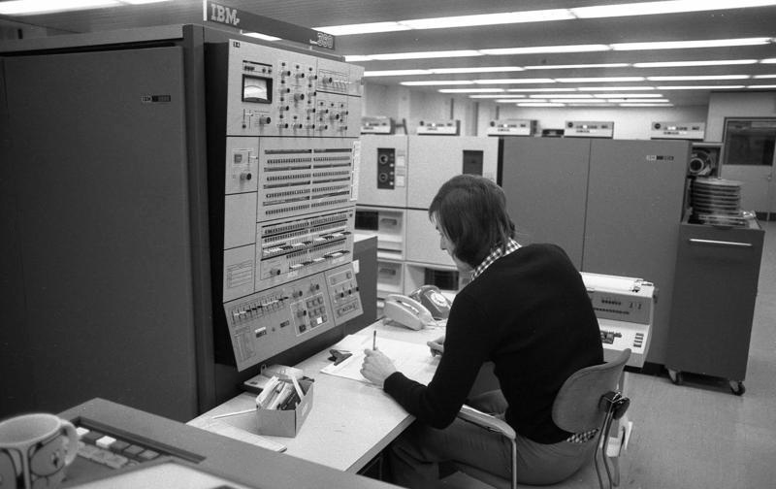
The Main Frames
IBM 1410
IBM 1302
IBM 7094
IBM 360/40
Notes:
IBM 1410
IBM 1302 Disk Drive – 58.5 Million Characters
7094 – 2 microsecond cycle, 32k 32 bit words
I learned to operate and program all of these wonderful machines
I was having a lot of fun there but something else caught my interest

Slide 10
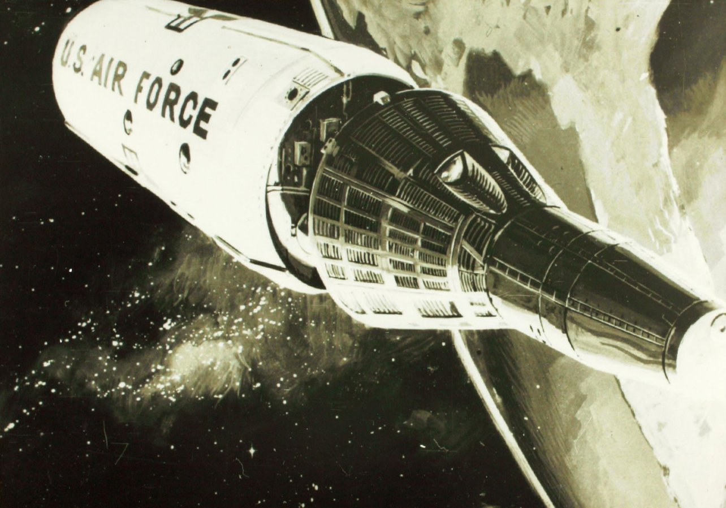
SPACE!
US Air Force Manned
Orbiting Laboratory
Notes:
Space Station
Spy in the sky
Gemini Space Capsule
2 crew for 40 days
Lockheed, Sunnyvale, CA
March 1969

Slide 11
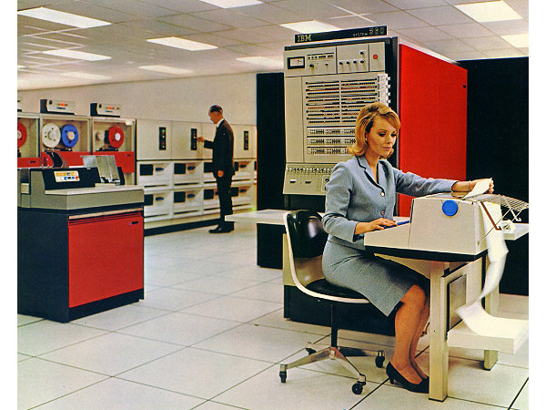
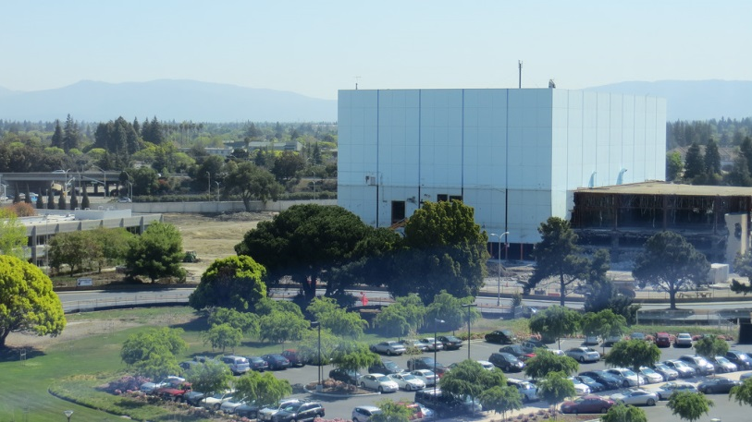
The MOL Control Center
IBM 360/65 (M65MP)
ARAND
Page Overlay Keyboard
The Blue Cube
Project Cancelled
June, 1969
Notes:
Unmanned satellites could do the same job, cheaper

Slide 12
IBM SBC
Service Bureau Company
Computer Time Sharing
Basic, Fortran, PL/I
Hired to work
on the
operating system

Slide 13
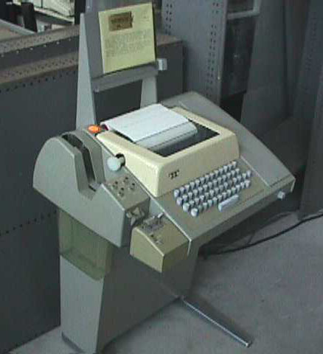
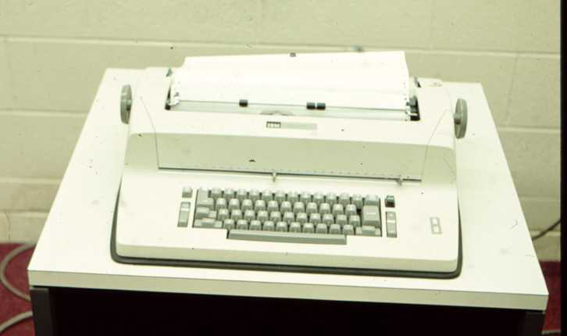
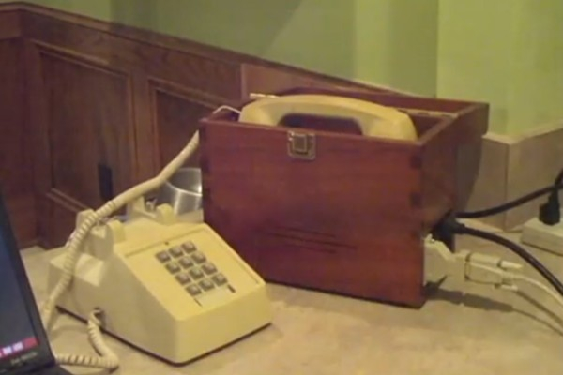
Call/360 Terminals
IBM 2741
ASR 33
Modem
Notes:
ASR 33 10 CPS
2741 13.5 CPS
Livermore Data Systems "Model A" Acoustic Coupler Modem
Had 2741 in my home

Slide 14
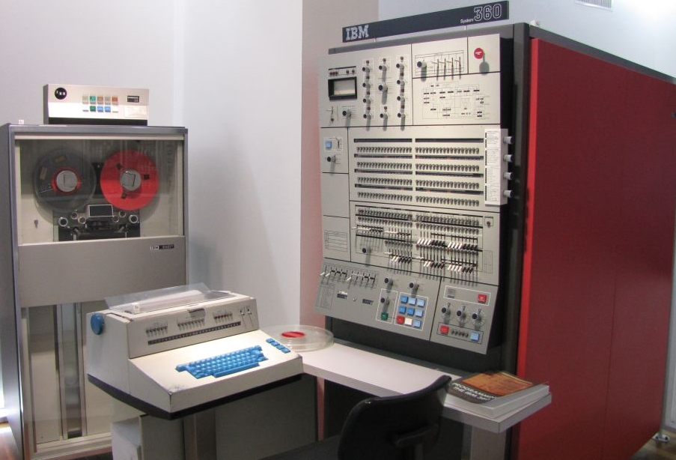
IBM 360 Model 50
SBC had eight 360/50s servicing the entire country

Slide 15
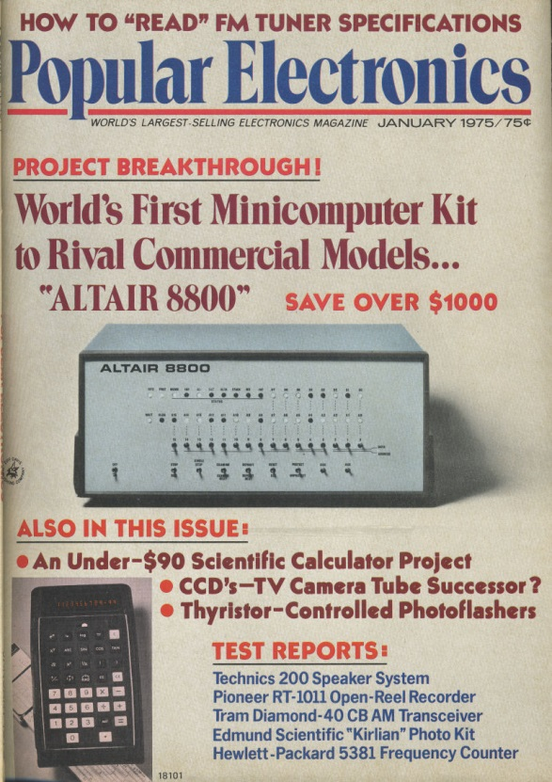
Microprocessors!
I WANT
MY
OWN
COMPUTER!
Notes:
January, 1975
$439 Kit
Does nothing
Have enter programs as ones and zero

Slide 16
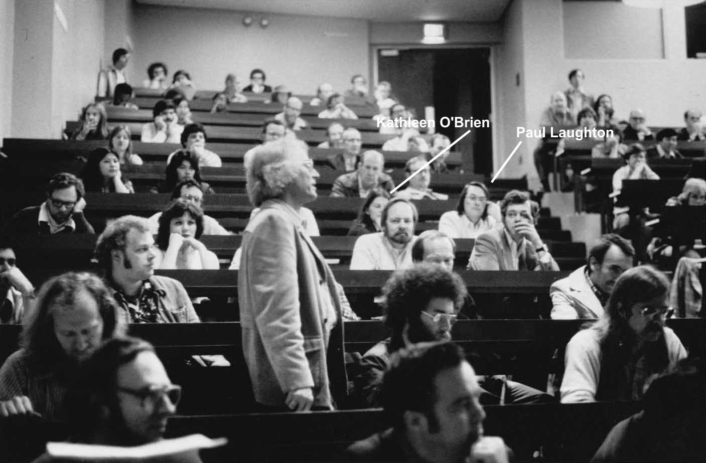
Homebrew Computer Club
Notes:
Personal Computers started by hobbyists
Met at an auditorium at Stanford
Exchange ideas on making our own computers
It was at these meeting that I met my future wife

Slide 17
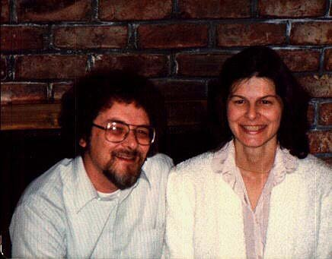
My Wife Kathleen O’Brien
Today
A professor of computer Science
San Jose State University
Notes:
This is a picture of us from the mid 70s.

Slide 18
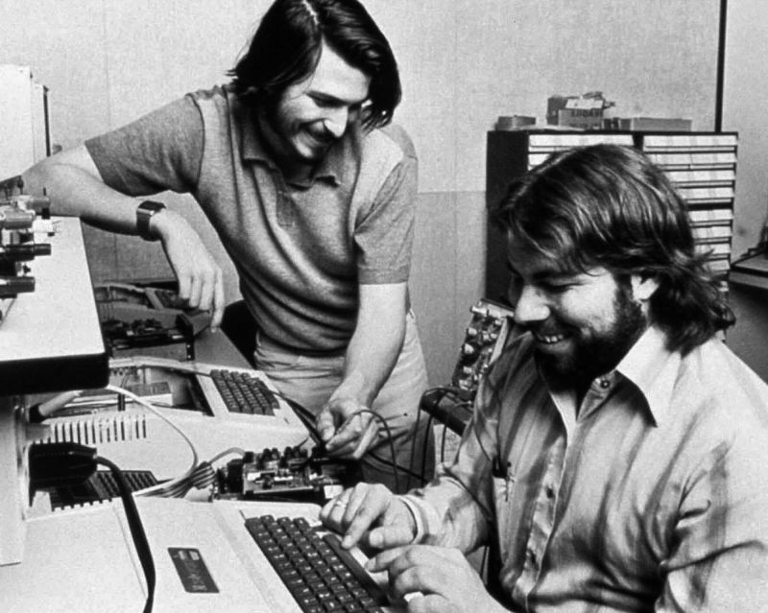
Steve Jobs & Steve Wozniak
Notes:
I also met these two guys at the Homebrew Computer Club

Slide 19
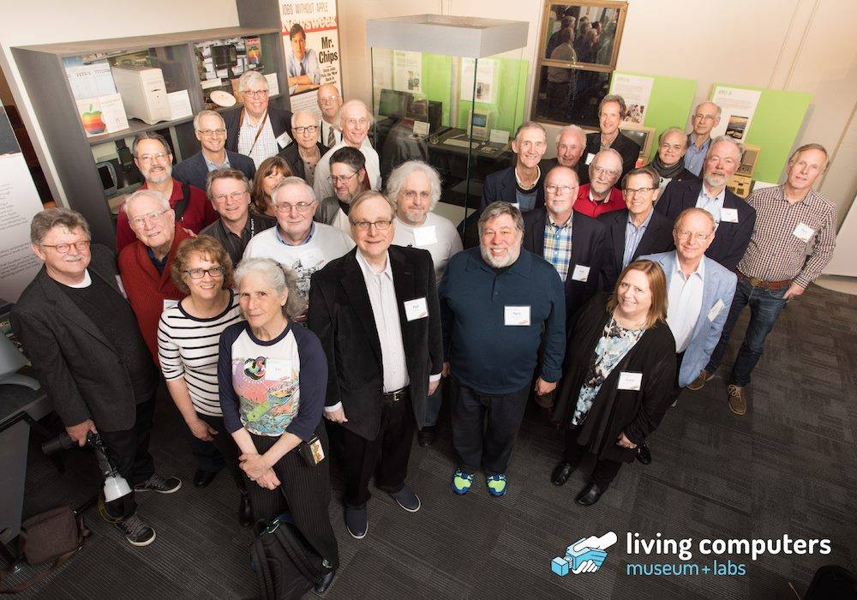
Homebrew Computer Club Reunion April, 2016

Slide 20
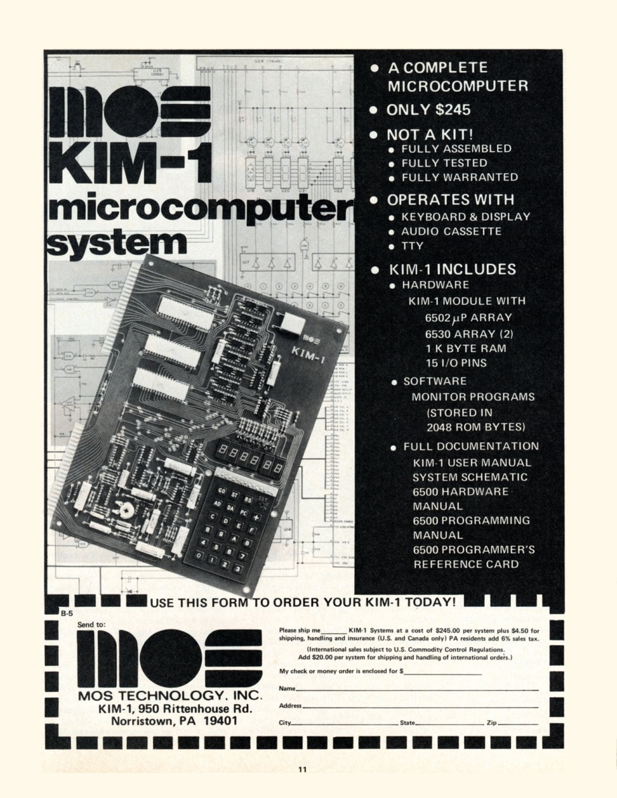
KIM-1
Notes:
1976
Prebuilt and tested single board computer
Built in monitor
Keyboard and display
I/O and audio cassette storage built in

Slide 21
Fun with the KIM-1
Wire wrapped 48k of static memory
Wrote 6502 Assembler in 360 Macros Wrote 6502 native assembler
Started to write a Basic interpreter
Notes:
This was all while I was still working for SBC

Slide 22
Time For A Change
Personal Computers will kill time sharing
Really wanted to work with microcomputers
Woz told me about a little company looking someone to write a Basic for Apple

Slide 23
SMI
Shepardson Microsystems Incorporated
Bob Shepardson (Shep)
Wrote software for very early microprocessors
National Semiconductor IMP-16
Contracted to write a Basic for Apple
Notes:
That little company was at …
Based on my professional background and computer hobby activities
Shep hired me

Slide 24
Apple Annie Basic* Development Environment
6502 assembler code onto punch cards
Assembled on Shep’s IMP-16 cross assembler
Object output on paper tape
Woz created Apple II paper tape reader interface card
Read into a 48k Apple II
* Atari Basic
Notes:
Apple II delivered to me by Jobs

Slide 25
Apple DOS The Beginning
Woz at SMI setting up the tape reader
Had developed a floppy disk drive
Tight HW & SW schedule
I volunteered to do the DOS
Shep, Woz and Jobs agreed
Started working immediately
Apple Annie Basic put on hold

Slide 26
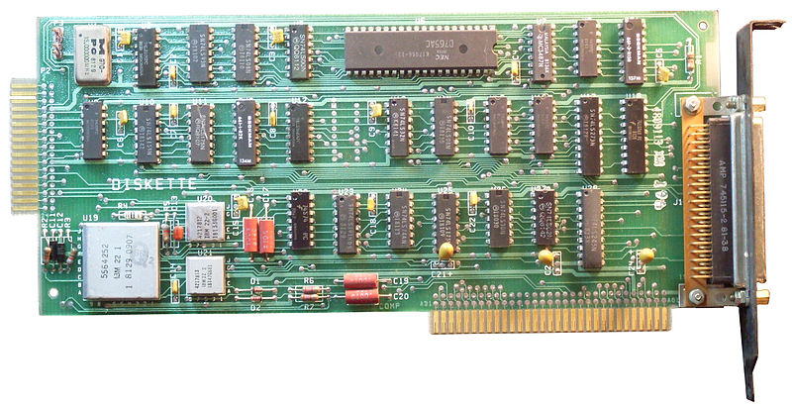
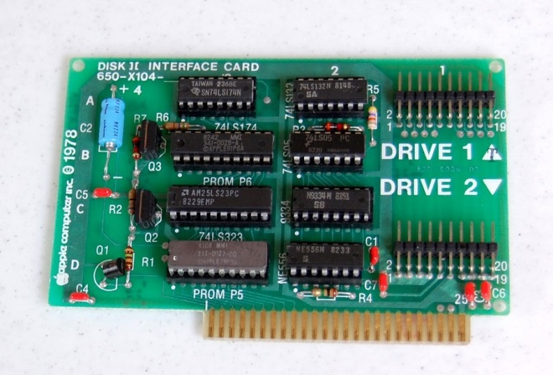
Apple DOS The Hardware

Slide 27
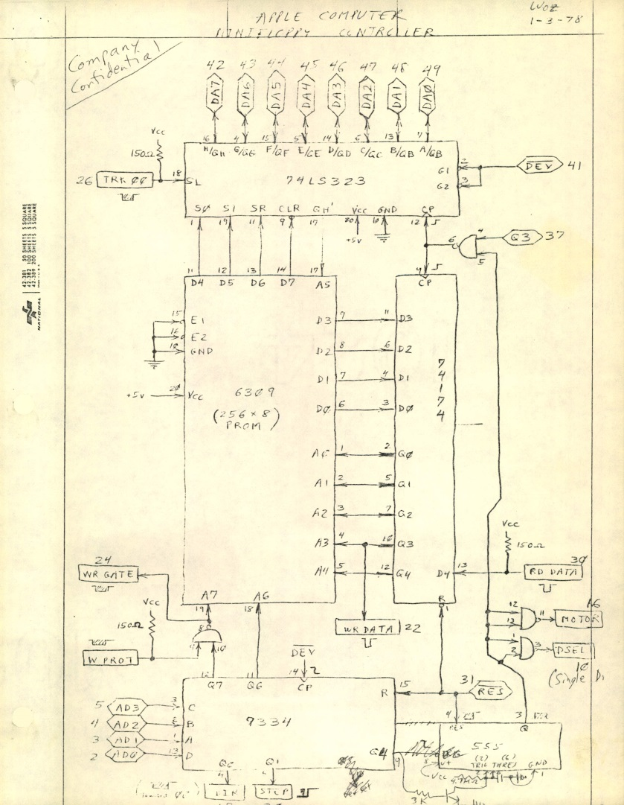
Apple DOS Controller Schematic

Slide 28
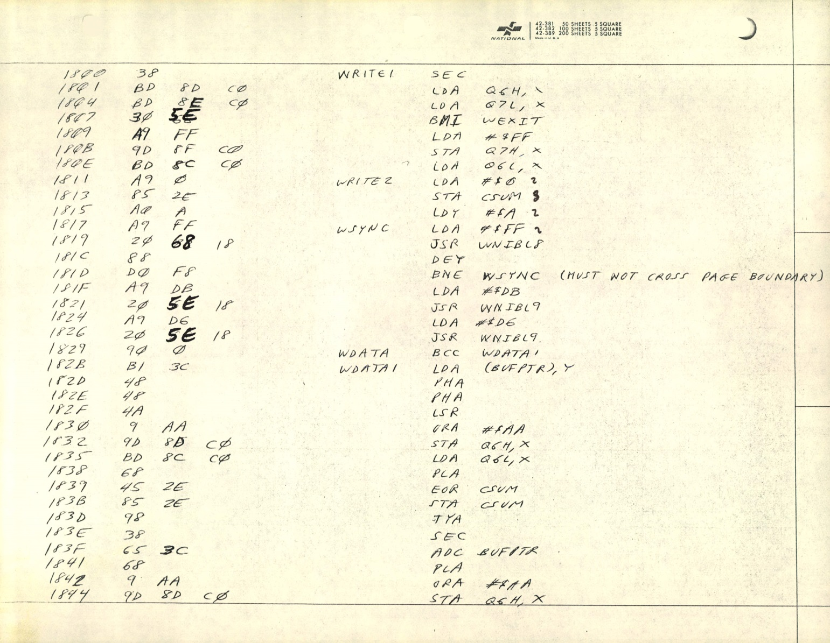
Apple DOS Read Write Track Sector (RWTS)
Notes:
The timing of events in this code was critical
Must not cross page boundary
Later versions of apple with faster clock had to slow down while doing disk I/O

Slide 29
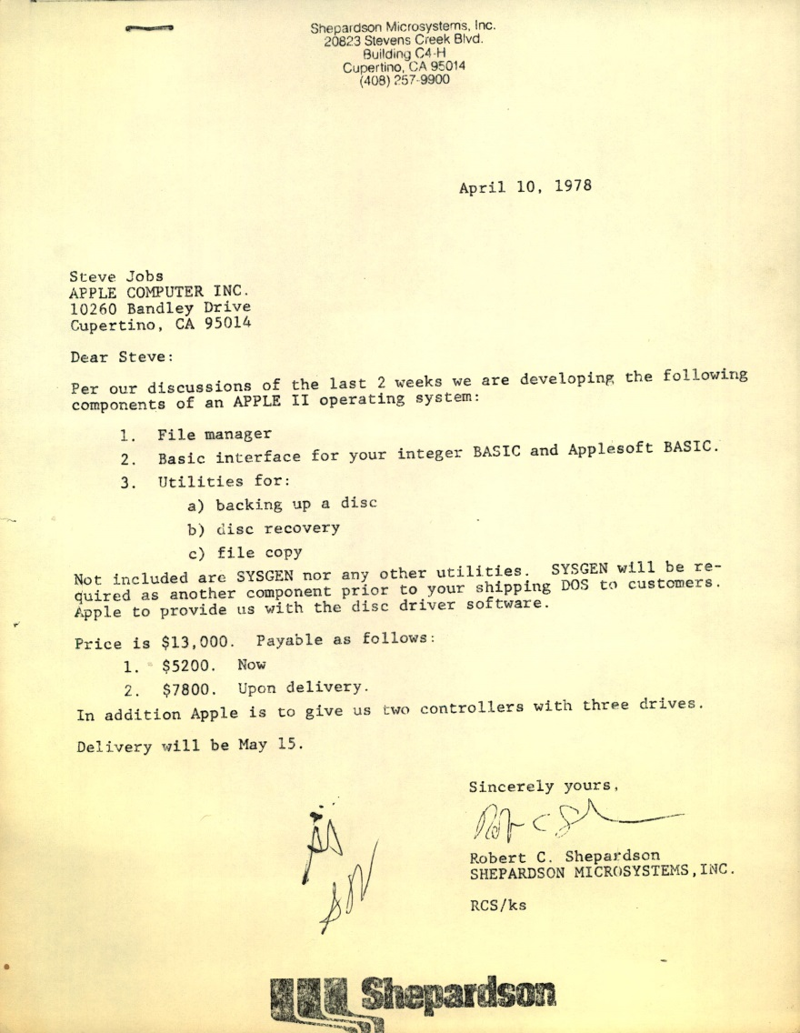
Apple DOS The Contract
$13,000
Signed: April 10, 1978
Delivery: May 13, 1978
Signed by: Jobs, Woz, Shep

Slide 30
Apple DOS Design
Keyboard
Monitor
Assembly
Language
Programs
Integer Basic
Applesoft Basic
Command Interpreter
Open
Close
Read
Write
Catalog
Init
etc
Data Control Blocks
File Manager
RWTS
Disk Drive
Notes:
DOS commands from running program were printed

Slide 31
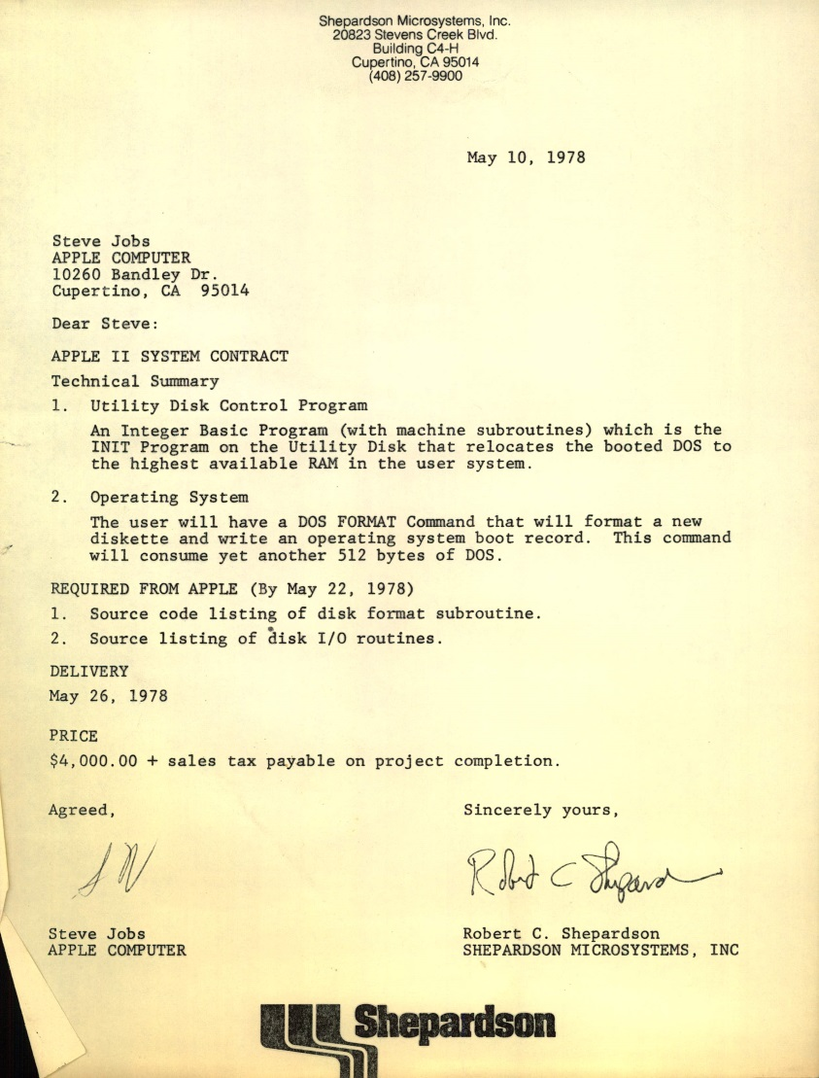
Apple DOS Contract Addition
May 10, 1978
DOS Relocation
Boot Disk
$4000
May 26, 1978
Notes:
May 13 original deadline

Slide 32
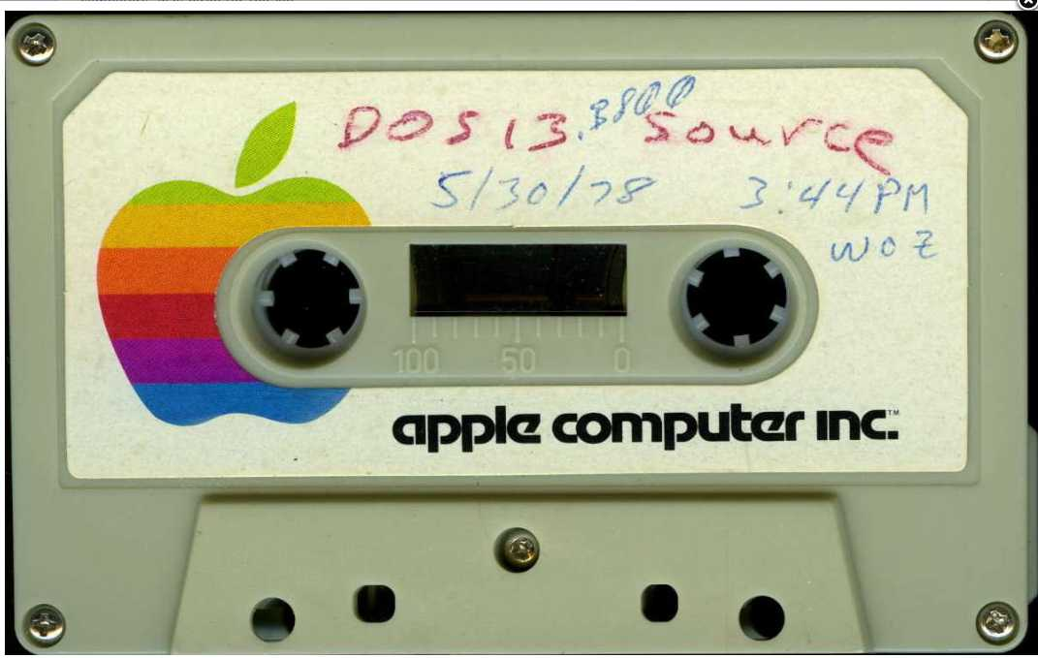
Apple DOS Initial Delivery
Delivered On Schedule

Slide 33
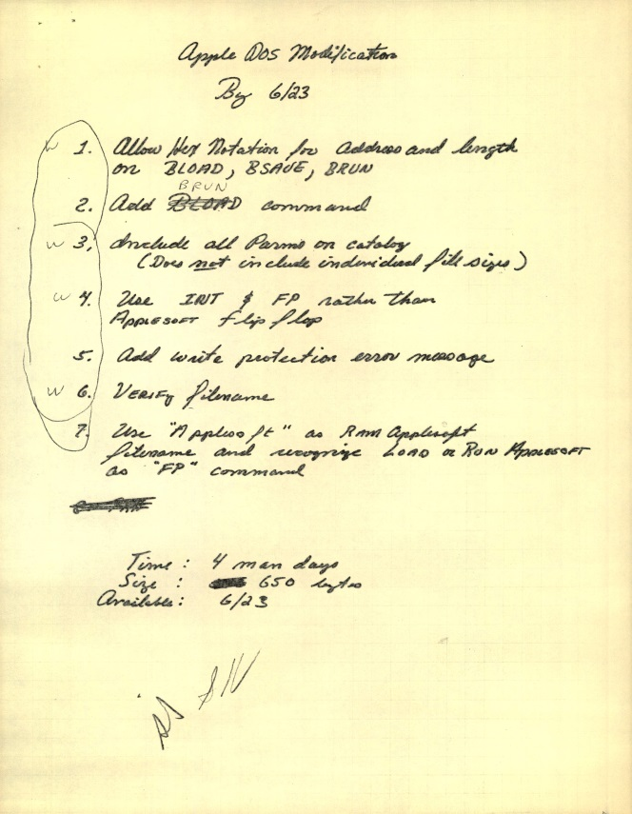
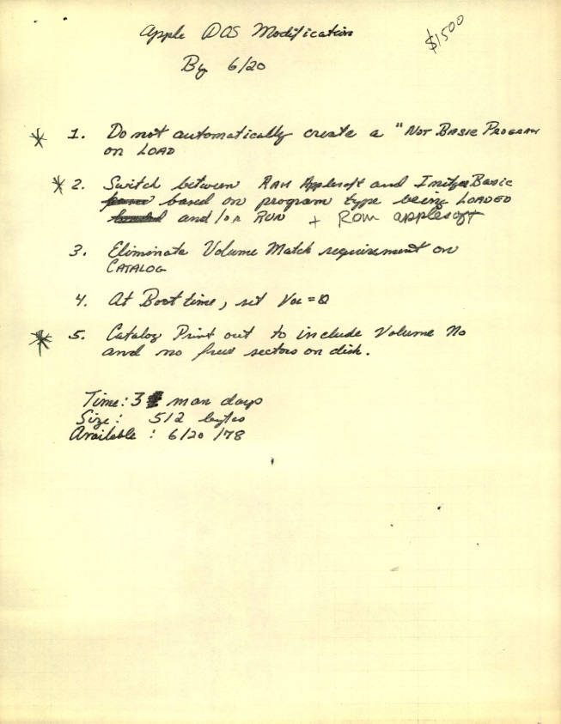
Apple DOS More Changes
Minor Changes
$2,000
Due June 23

Slide 34
Apple DOS No News Is Good News
Delivered changes by end of June
Resumed work on Basic
Shep had hired Kathleen O’Brien
Heard very little from Apple about DOS
July, August, September

Slide 35
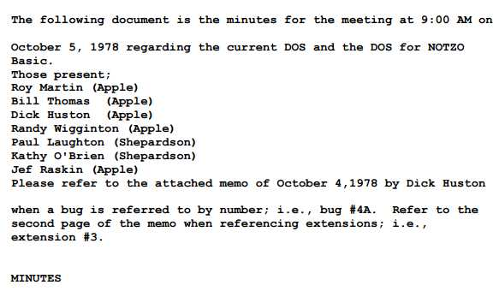
Apple DOS October Meeting
Kathy and I called to meeting at Apple
DOS bugs
Issues with Basic
Meeting Minutes
Randy Wiggington
Notes:
Give details

Slide 36
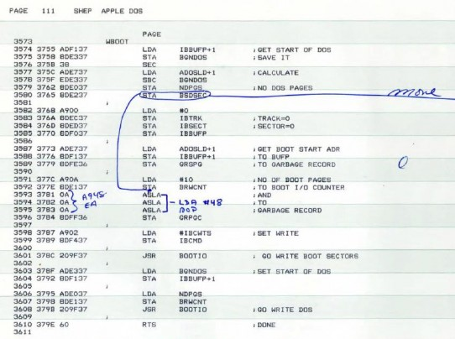
Apple DOS Final Act
Final Delivery – 10/6/78
Marked up listing fixing bugs
Source on diskette
Dick Huston took over
I Never touched it again

Slide 37
Apple Annie Basic
No Specifications other than a “Simple Basic”
Jeff Raskins assigned to write manual
Jeff wanted a very rich and powerful Basic
Projected size > 32k
Jeff called it NOTZO Basic

Slide 38
NUTZO BASIC
No one at Apple responsible for the Basic
Apple told us they would fix the problem
John Couch hired as software VP
John’s solution: Cancel the project
Which was fortuitous for us…

Slide 39
Enter Atari
Atari starting working on 400 and 800 PCs early 1978
Planned to use Microsoft 6502 Basic
By late summer ‘78, MS Basic was 12k
Too big to fit into 8k cartridge
Wanted to ship by May, 1979
Came to SMI for help

Slide 40
Atari Proposal
SMI offered a new, custom Basic
Plus a Disk File Management System
Atari agreed late October, 1978
Delivery: April 6, 1979
$1000 Bonus/Penalty for every week early/late

Slide 41
Atari Contract Work Begins
Apple Annie Basic transformed into Atari Basic Apple DOS transformed into Atari Disk FMS
Development testing done on Apple II

Slide 42
Atari Basic & FMS First Working Delivery
Delivered: December 22, 1978
In time for January, 1979 CES
About 12 weeks development time
$12,000 Bonus

Slide 43
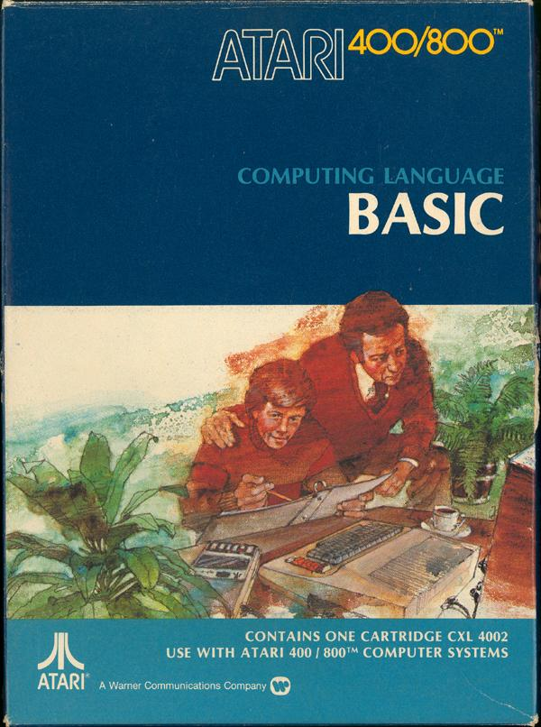
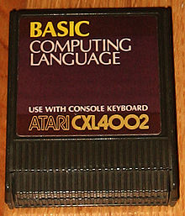
Atari Basic As Sold

Slide 44
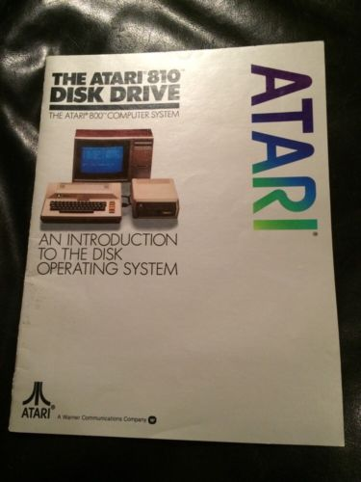
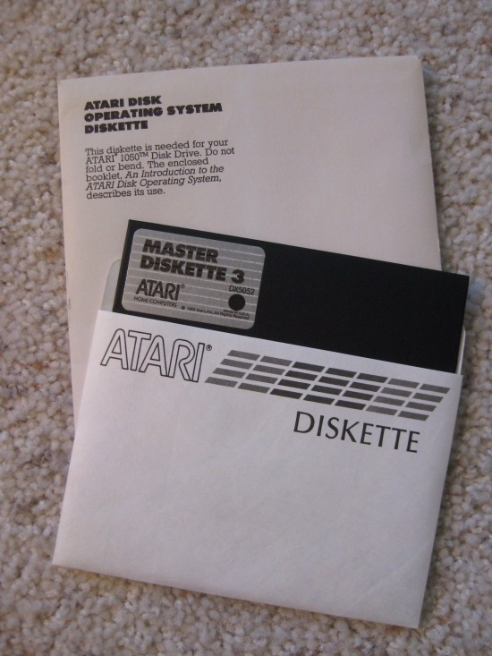
Atari FMS As Sold

Slide 45
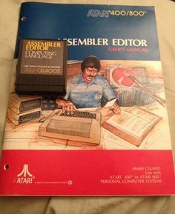
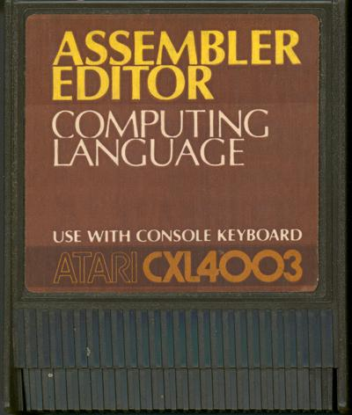
Atari Assembler Editor
Author: Kathleen O’Brien

Slide 46
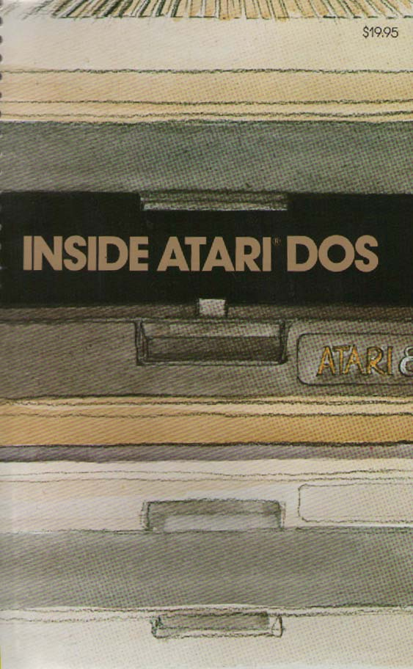
Inside Atari DOS
COMPUTE! Books
Bill Wilkinson
Paul Laughton
Provides Listing
And
Detailed Explanations

Slide 47
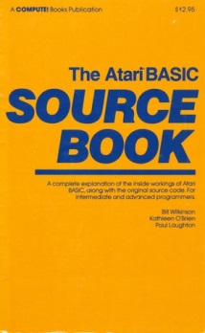
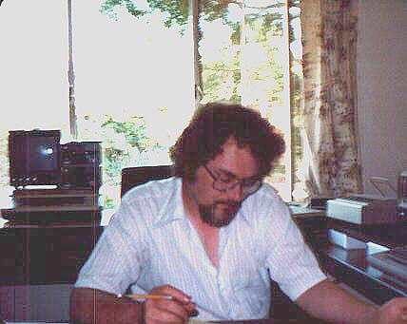
Basic Source Book
COMPUTE! Books
Bill Wilkinson
Kathleen O’Brien Paul Laughton
Provide Listing
And
Detailed Explanations

Slide 48
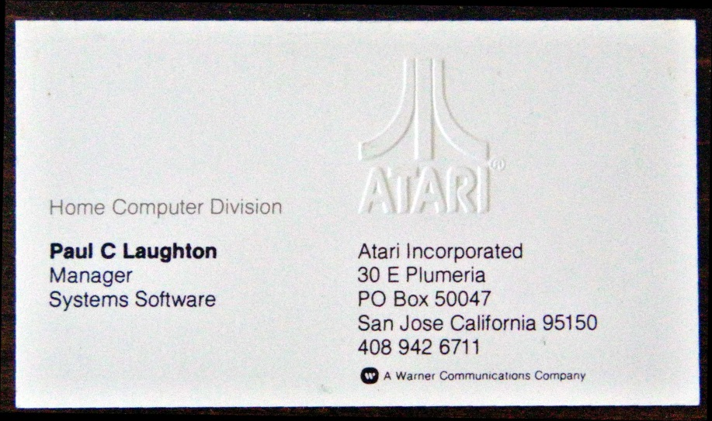
The 80s Atari
Shep was loosing interest in the business
Kathleen went back to SBC
SMI no longer any fun
Atari made me an offer that I could not refuse
Entered the management track

Slide 49
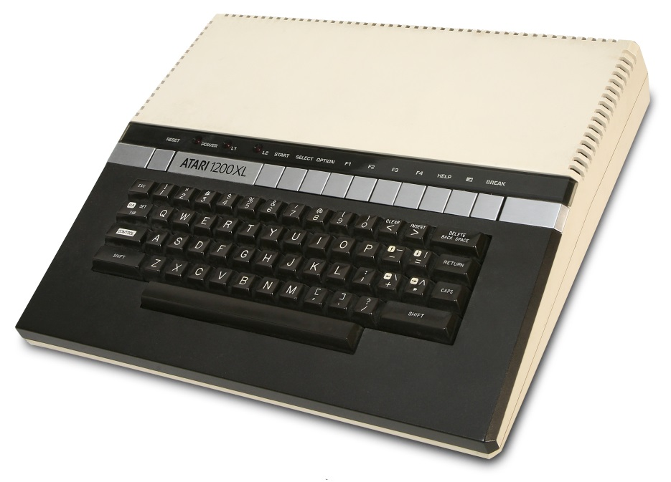
The 80s Atari 1200 XL
Managed system software team
Part of the computer design team
Help key
Self test
Screen, memory
Sound
Keyboard

Slide 50
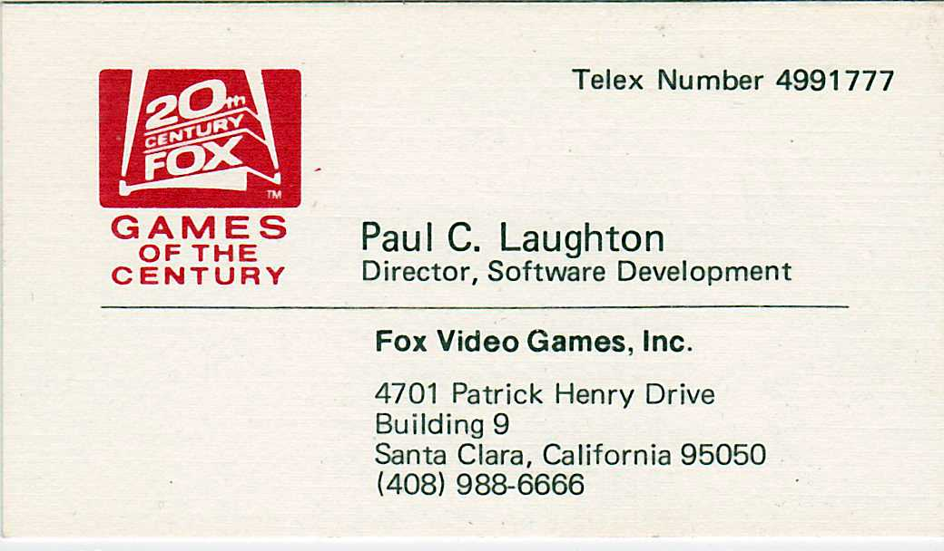
The 80s Fox Video Games
Atari was in trouble
Offered job at Fox Video Games
Game development as an engineering task
One game, many machines
Games based upon Fox Properties
Fast Eddie, Porky’s, Alien, M*A*S*H, etc.
Give My Regards To Broad Street
Paul McCartney
Video game business shake out We were Shut down

Slide 51
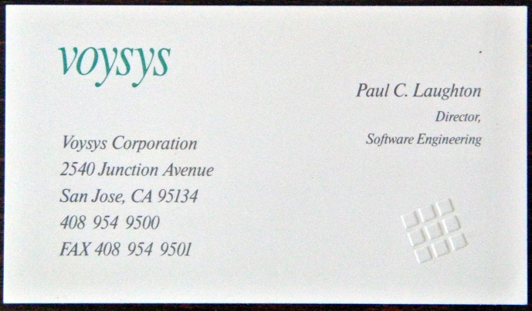
The 80s Voysys
An OEM voice mail provider
One of the founders
Lots of turmoil and infighting
No fun
Resigned

Slide 52
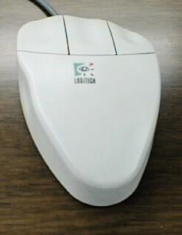
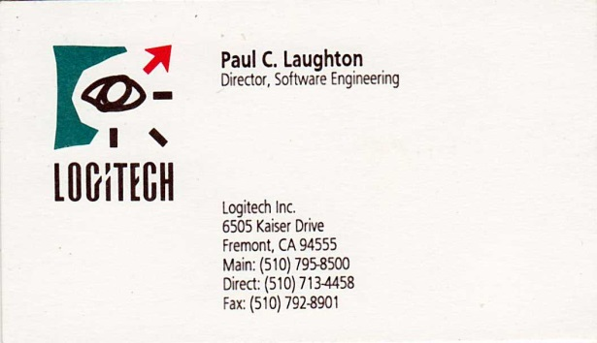
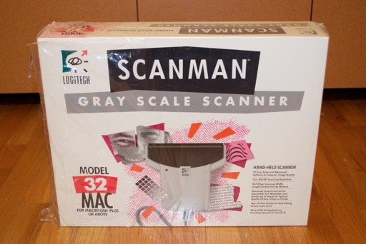
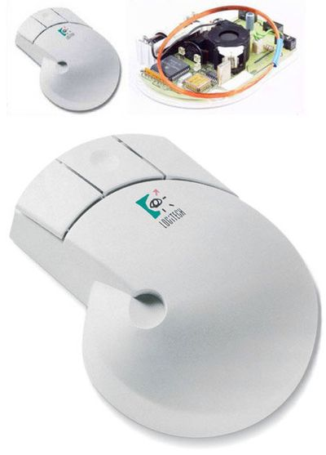
Logitech
Notes:
Products my team was writing software for

Slide 53
Dycam Model 1
376x240 Pixels
8 Bit Grayscale
32 images
Logitech made an offer

Slide 54
Logitech Fotoman
Logitech paid $1,000,000
Developed software for PC and Mac
Market: Relators, Insurance + anyone needing fast turn around
OEM versions for medical use
Company reorganized
Functional units -> Business Units
Director, Camera Development
Started design of a Color Fotoman
Notes:
Fotoman used a black and white TV camera sensor
We decided we could make a color Fotoman using a color TV sensor

Slide 55
Color Fotoman
While working on color Fotoman
Representatives from Kodak
Digital camera prototype 24 bit color, 768x512 pixels, 48 images
I was interested
I visited Kodak and Chinon in Japan
Logitech signed contract with Kodak

Slide 56
Logitech Pixtura
My team developed a complete set of specifications
Did the industrial design

Slide 57
Logitech Pixtura
Design work began in earnest
Lots of time in Japan

Slide 58
Kodak DC40
Kodak made a proposal
Kodak would also sell the Pixtura as the DC40
Logitech would not pay any further development cost
Kodak would pay Logitech a royalty
I would continue as project manager
Logitech agreed

Slide 59
Digital Camera Twins
Kodak sent royalty checks directly to me
Royalties more than paid for Logitech development expenses

Slide 60
Logitech PageScan Color Design
Design a sheet fed scanner
USB Powered– No wall wart
Notes:
One photo sensor per pixel exposed to sequence of red, green and blue
From just three LEDS

Slide 61
PageScan Windows 98
Windows 98 has robust USB support
PageScan driver to be included in W98
MS thought PageScan showed power of USB
Invited me to speak at WinHEC 97

Slide 62
Alan Cooper
Father of Visual Basic
World class UX designs 2017 Computer History Museum Fellow
Author of several books
COOPER.COM
Notes:
Personas

Slide 63
PageScan Software
Hired Alan Cooper’s company to do the design
Cooper’s design was everything I wished for
Easy to use but powerful

Slide 65
Management Information Systems
Assigned to develop specifications for
a new MIS for Logitech. Hired a MIS consultant.
Spent three months with her visiting every
Logitech office around the world.
Developed the specifications.
Hired a company to implement.

Slide 66
Flashpoint
Steve Jobs returns to Apple
Eliminates all non computer products
Camera product development group
Spun off from Apple and named Flashpoint
Flashpoint’s Product
Camera Operating System for camera OEMs
Customer adapts OS to their camera

Slide 67
Flashpoint
Building OS for the Kodak DC-260
Flashpoint looking for Engineering VP
Kodak’s team – same people as DC40 team
Kodak suggested me as the VP

Slide 68
Flashpoint
Code base was awful
Impossible for customer to DIY
Every project was custom built by FP
Could not get second round of funding
I retired in 2000
Notes:
During the first ten years of my retirement
Worked on my hobbies: woodworking, amateur astronomy, amateur radio (K4KDJ)
Volunteer work

Slide 69
BASIC! For Android
Decided to write an App for Android A Basic interpreter was an obvious choice
First released in December, 2010
Richard Feynman Observatory
RFO

Slide 70
BASIC! For Android Stand Alone Apps
Most of Android’s features accessible from BASIC!
Can Transform BASIC! program into a stand alone APK

Slide 71
BASIC! For Android Community Development
Open Source
GNU General Public License
Put on GitHub in October, 2013
User Development Team
111,000 Downloads
4.5/5.0 Rating

Slide 72
Today
Docent Leading Tours Teaching Computer History

Slide 73
IBM 1401 Restored and Demonstrated

Slide 74
Do what you love,
Love what you do,
And you will love your life
Paul.laughton@gmail.com
www.laughton.com/VT18.xps

